Slide 1
FY 24 Good Jobs Challenge NOFO

Slide 2

Office Hours Agenda
We'll review the following:
Overview of the Good Jobs Challenge
Overview of FY 24 NOFO
2

Slide 3
Overview of Good Jobs Challenge

Slide 4




Good Jobs Challenge Vision
The Good Jobs Challenge (GJC) started with a $500 million grant program funded by the American Rescue Plan. It aims to get Americans into quality jobs by linking workforce training to employer workforce needs.
Provide American workers with access to good jobs by establishing or strengthening regional workforce training systems
Focus on underserved communities, high quality training, wrap around supports, and earn and learn programs.
Demand/employer driven approach to workforce development that emphasizes strong employer engagement and commitments to hire to support and strengthen local communities.
Intentional connection of workforce and economic development by focusing on sectoral partnerships, employer leadership, and alignment with regional strategy to reduce outmigration
FY 24 Good Jobs Challenge
Program continues with a $25 million competition.
This will fund ~5-8 grantees with awards between ~$1 million- $8 million.
3

Slide 5
Program Design: Sectoral Partnerships
Adult basic education
Strategic Partners:
Organizations involved in workforce development
Organized labor
Industry Partners:
Partnership of employers from the same industry
Business alliances / chambers
Backbone Organization
Lead entity of sectoral partnership, usually one of the strategic partners.
  Backbone Organizations:
  Serve as the intermediary between all stakeholders and work to ensure programs get implemented and regional milestones are met
  Must be named as part of the EDA application
  May make subawards to other partners
  Should be an eligible entity under this NOFO
Institutions of higher education (e.g., universities, community colleges)
Workforce boards
Community-based organizations
Human services organizations
4

Slide 6
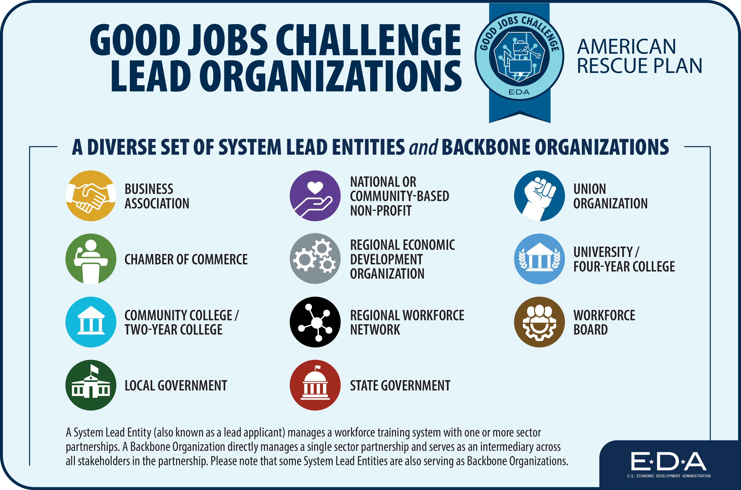
Program Footprint
Good Jobs Challenge grantees reflect the diversity of stakeholders in workforce development.
5

Slide 7
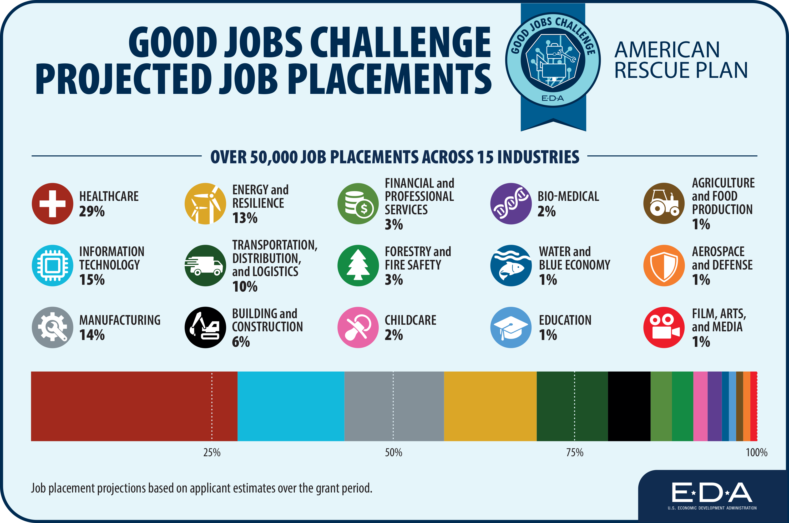
Program Footprint
Good Jobs Challenge supports in-demand industries that serve the national interest.
6

Slide 8
Notice of Funding Opportunity

Slide 9
Good Jobs Challenge NOFO Overview
Purpose
Supporting regional training systems in designing and implementing training for established sectoral partnerships that place program participants in good jobs and advance industries in key technology focus areas..
Focus on training and placing program participants from historically underserved populations and workers adversely impacted by changes in technology and other economic shocks into good jobs.
Core Design
Backbone Organizations lead established sectoral partnerships.
Design programming and train for jobs that advance an industry in a key technology focus area.
Train program participants and place them into jobs that meet the Good Jobs Principles.

Slide 10
Good Jobs Challenge NOFO Overview
Eligible Entities
Other Eligibility Requirements
Eligible applicants for investment assistance include a(n):
District Organization of an EDA-designated Economic Development District (EDD);
Indian Tribe or a consortium of Indian Tribes;
State, county, city, or other political subdivision of a State, including a special purpose unit of a State or local government engaged in economic or infrastructure development activities, or a consortium of political subdivisions;
Institution of higher education or a consortium of institutions of higher education; or
Public or private non-profit organization or association acting in cooperation with officials of a political subdivision of a State.
The applicant must:
Meet Cost Share or Matching Requirements
Meet the Distress Criteria
Align with the region’s Comprehensive Economic Development Strategy (CEDS)
Align with EDA’s Investment Priorities

Slide 11
Good Jobs Challenge NOFO Overview
Jobs must align with the
Good Jobs Principles
Jobs must advance industries in Key Technology Focus Areas
A “good job” is defined as a paid position of regular employment that aligns with the Good Jobs Principles.
The Good Jobs Principles include jobs that ensure all workers are:
  Paid a stable, predictable living wage
  Receive basic benefits (e.g., paid leave, health insurance, retirement/savings plan)
  Have safe working conditions
  Can form and join unions and engage in protected, concerted activity without fear of retaliation
  Have equitable opportunities and tools to progress to future good jobs
More on the Good Jobs Principles can be found at:
  https://www.dol.gov/general/good-jobs/principles
Artificial intelligence, machine learning, autonomy, and related advances;
High performing computing, semiconductors, and advanced computer hardware and software;
Quantum information science and technology;
Robotics, automation, and advanced manufacturing;
Natural and anthropogenic disaster prevention or mitigation;
Advanced communications technology and immersive technology;
Biotechnology, medical technology, genomics, and synthetic biology;
Data storage, data management, distributed ledger technologies, and cybersecurity, including biometrics;
Advanced energy and industrial efficiency technologies, such as batteries and advanced nuclear technologies, including but not limited to for the purposes of electric generation; and
Advanced materials science, including composites 2D materials, other next generation materials, and related manufacturing technologies.

Slide 12
Good Jobs Challenge NOFO Overview
Funds Activities for
Program/Training Design
Funds Activities for
Program/Training Implementation
Funding for a sectoral partnership to:
Identify the skills needed by industry and workers, develop the skills training curriculum and materials
Secure technical expertise needed to train workers with the skills needed by businesses, including providing professional development and capacity-building to trainers and educators
Funding for a sectoral partnership to:
Deliver workforce training and wraparound services that place workers into good jobs through a new or expanded sectoral partnership

Slide 13
Good Jobs Challenge NOFO Overview
Supports Wide Range
of Non-Degree Training Models
Prioritizes Strong Employer Engagement & Commitments
Registered Apprenticeship Programs
Skills Training Programs
Pre-apprenticeship Programs
Other Work-and-Learn Models
Certification or Credentialing Programs
Labor Management Training Programs
Work-and-Learn, including Registered Apprenticeships
Employer Commitments, including commitments to:
  Hire
  Offer benefits
  Donate equipment and staff time
  Serve in advisory capacity

Slide 14

Applicant Example: Investing in Robotics and Autonomy
Applicant is training in a job that aligns with the Good Jobs Principles.
The demand for autonomous technology has led to a need for mechatronics technologists and technicians who operate, test, maintain, or adjust robotics.
The region is proposing a work-and-learn model for training in these occupations as well as wraparound supports such as public transportation support to help participants access training.
The applicant is advancing the robotics, automation, and advanced manufacturing key technology focus area.
Applicant is using an earn and learn to satisfy employer commitments and engagement.
Applicant has a strategy for providing wraparound supports to participants.
Applicant is advancing an industry in a key technology focus area.

Slide 15
Applicant Example: Investing in Predictive Healthcare Technologies and Healthcare Information Technology
To advance that industry, the region needs more non-traditional pathways.
This region proposes a healthcare sectoral partnership that will support the training of radiologic and biological technicians.
Applicant provides letters outlining employer commitments to hire program participants that complete training.
Aims to advance the biotechnology, medical technology, genomics, and synthetic biology key technology focus area.
Applicant is training in a job that aligns with the Good Jobs Principles.
Applicant has employer commitments.
Applicant has a strategy for providing wraparound supports to participants.
Applicant is advancing an industry in a key technology focus area.

Slide 16
Application Components
Project Narrative (No more than 15 total pages 12-point font, 1 inch margins)
Budget Narrative and Staffing Plan
Matching Share Commitment Letters (One Per Match Source)
SF-424 (Application for Federal Assistance)
SF-424A (Budget Information Non-Construction Programs)
CD-511 (Certification Regarding Lobbying)
Letters of Commitment from Sectoral Partnership Members and Employer Partners
Distress Criteria Data
List of FIPS codes in the Project Service Area
The deadline for the receipt of an application is September 27, 2024. Applications must be submitted on EDGE.

Slide 17
Scoring Rubric
Category | Points | Key Question
Strength of Sectoral Partnership | 15 | Are the right partners in the sectoral partnership?
Strength of Employer Partnerships | 10 | Are employer relationships likely to lead to placements in good jobs?
Readiness of the Sectoral Partnership | 15 | Can the sectoral partnership implement the plan?
Regional Needs and Alignment | 15 | Does the proposal align with the KTFAs and the needs of the region?
Tech Hubs Benefit of Designation | 5 | If the project is a part of a Tech Hubs consortium, how will the project advance the work of the Tech Hub?
Project Impact & Feasibility | 20 | Does the plan (projects and budget) lead to a successful project?
Regional Investment and Sustainability | 10 | Does the project have the support of other regional players that will lead to long term sustainability?
Equity | 15 | Does the project have a plan to support the success of participants that are historically underserved?

Slide 18
Tech Hubs Benefit of Designation
Recognizing Tech Hubs’ potential for creating new good jobs, applications that propose sectoral partnerships affiliated with a Tech Hub will earn up to 5 additional points during merit review and consideration in the overall portfolio selection.
If the project’s location is in a geographic region designated as a Tech Hub by EDA and the proposed sectoral partnership is aiming to align with and advance the Tech Hub’s strategy:
  Describe how the proposed project will align with and advance the Tech Hub’s strategy and place participants in good jobs within the award period of performance; and
  Provide evidence of the applicant’s membership in the Tech Hub’s consortium.

Slide 19
Questions

