Slide 1
VISTA Informational Webinar for EDDs July 15, 2019

Slide 2
AmeriCorps VISTA (Volunteers in Service to America) is a federal anti-poverty program founded in 1964 which provides full-time volunteers to support projects in communities served by nonprofits, NGOs, and local governmental organizations around the country.
VISTA Members are people ages 18 and older who commit a year of full-time, 40 hours per week service to help local communities build capacity to develop lasting solutions to poverty in America.

Slide 3
EDA’s mission is to lead the federal economic development agenda by promoting innovation and competitiveness, preparing American regions for growth and success in the worldwide economy.
The AmeriCorps VISTA mission is to strengthen organizations that alleviate poverty through volunteering and the mobilization of resources.
Notes:
EDA provides grants to state and local government, Indian tribes, Economic Development Districts, public and private non-profits, universities and other institutions of higher education to support the development and implementation of economic development strategies for economically distressed communities.
EDA’s goal is to encourage private capital investment in the nation’s most economically distressed regions, thereby creating and retaining higher-skill, higher-wage jobs

Slide 4
EDA – VISTA Project History
2016
4 VISTAs are placed with EDDs in Texas
2017
Program opens to 10 EDDs across the AURO region
Addition of VISTA Leader
2018
AURO to host 15 VISTAs
DRO opens program to 5 EDDs in Colorado and Utah
2019
AURO to recruit host 15 VISTAs
DRO extends program to all regional states with 10 total VISTAs
Each program will have 1 VISTA Leader

Slide 5
About the Program
How it Works
2019 Timeline
Types of Projects
Associated Costs
Party Responsibilities & MOA
Training and Orientation

Slide 6
How it Works
After 3 years, the EDD will need to compete to continue participating
EDD designates a Capacity Building project
Individual VISTAs serve for 1-3 years of the project
EDD joins the EDA VISTA Program for a 3-year period
Notes:
Capacity Building Project planning, implementation, and sustainability

Slide 7
2019 Timeline
August 1: Letters of Interest Due
August 8: Determination and Notification
August 12: Supervisor Orientation Call
September - November: Recruitment
December: VISTA Selection Finalized
January: VISTA Start of Service
Start in office
Virtual Pre-Service Orientation
EDA Welcome Call
March/April: EDA Regional Office Orientation

Slide 8
Types of Projects
Capacity Building
Unique task
VISTAs should be working on pressing needs projects for each District but keep in mind:
Alignment with the EDD operations of research, planning, and implementation of economic activity and its integration of activities with other organizations, and
Primary assignment with the EDD rather than a sub-organization

Slide 9
Types of Projects
Examples of past focus areas:
Survey, assessment, and growth strategy for regional businesses development
Feasibility for localized development projects
Economic development education and community engagement
Facilitate localized or value add Comprehensive Economic Development Strategy (CEDS) work
Specific focus on: disaster recovery and mitigation, industry expansion, brownfields, communication strategy, etc.

Slide 10
Associated Costs
VISTA receives stipend from AmeriCorps VISTA
Stipend is $958/month
Receive post-service benefits including stipend & NCE
EDD pays for all VISTA work related expenses
Expenses can range from $300-$1000/month
Pilot program averaged less than $10k/year
Expenses include: desk space, travel, phone lines, trainings, etc.
Notes:
Education $5,920 first 2 years, stiped $1,300

Slide 11
Responsibilities
Grant Administration
Daily Supervision
Recruiting
EDA
EDD
Orientation and Training
Monthly Calls
VISTA Costs
Interfacing with CNCS
Monthly Reporting

Slide 12
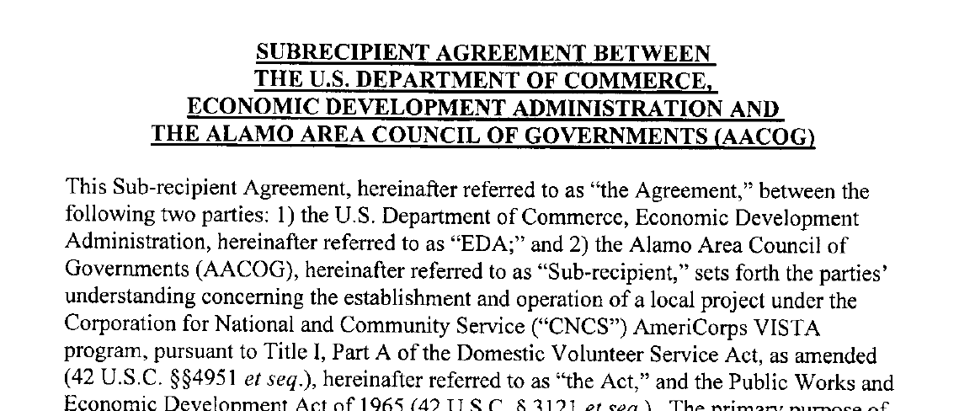
MOAs
Each EDD will be required to sign a MOA with EDA outlining the roles and responsibilities of each party.

Slide 13
Training and Orientation
AmeriCorps VISTA provides Virtual Pre-Service Orientation (PSO)
EDD provides on-site orientation and ongoing training
EDA Virtual Orientation
EDA provides economic development in service training in Austin or Denver
VISTA Leader will facilitate on-going support and training opportunities

Slide 14
Letters of Interest
VISTA project focus:
Alignment with the EDD operations of research, planning, and implementation of economic activity and its integration of activities with other organizations, and
Primary assignment with the EDD rather than a sub-organization
Supervisor: Please include brief bio including their supervising experience and how their role relates to the identified project
Recruitment: Please outline as many recruitment avenues and targets with as much detail as possible

Slide 15
Please submit to:
AURO
Sally Waley
swaley@eda.gov
512-381-8141
DRO
Stacey Webb
swebb@eda.gov
(303) 844-5364

Slide 16
Questions?

