Slide 1



THE OFFICE OF INNOVATION & ENTREPRENEURSHIP
Full Application Informational Webinar
May 5, 2020

Slide 2



ALWAYS REMEMBER!
BUILDING REGIONAL ECONOMIES THROUGH SCALABLE STARTUPS

Slide 3



TOPICS TO BE COVERED
The Numbers
Technical Requirements
The Application
The Scoring
Next Steps

Slide 4
THE NUMBERS
Where did we land?

Slide 5




The Numbers
TOTAL
609
417
146
46
VENTURE
CAPITAL
INDUSTRY

Slide 6

The Numbers
Encourage
22.7%
ENCOURAGE V. DISCOURAGE
138
Encourages
471
Discourages
Discourage
77.3%

Slide 7
14.3%
$5M
Capital
11.4%
$4M
Industry
The Numbers
TOTAL FUNDING AVAILABLE
$26M
Venture
74.3%

Slide 8

TECHNICAL REQUIREMENTS
DON'T GET KNOCKED OUT BY A MISTAKE
Read the Notice of Funding Opportunity thoroughly and don't wait until the last minute to submit.

Slide 9


Application Systems
All of these are necessary to apply
AOR
Grants.gov
SAM
5
DUNS Number
EIN
4
3
2
1

Slide 10

Eligible Entities
Who is eligible to apply? (see NOFO)
A State;
An Indian tribe;
A city or other political subdivision of a State;
An entity whose application is supported by a State or a political subdivision of a State and that is...
- a nonprofit organization
- an institution of higher education
- a public-private partnership
- a science or research park
- a Federal laboratory
- a venture development organization
- an economic development organization
A consortium of the above

Slide 11
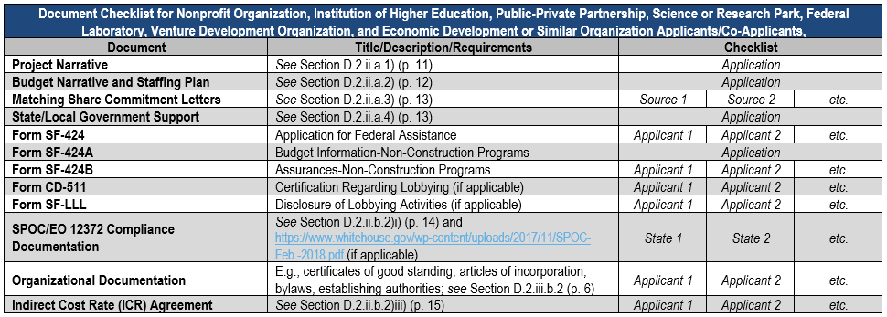
Technical Checklist
Use Appendix D to ensure you have documents - these can vary depending on your entity type

Slide 12

The Full Application
LINK TO ACCESS THE GRANTS.GOV PORTAL
Your Concept Proposal response letter contains the link to access the grants.gov application portal.

Slide 13
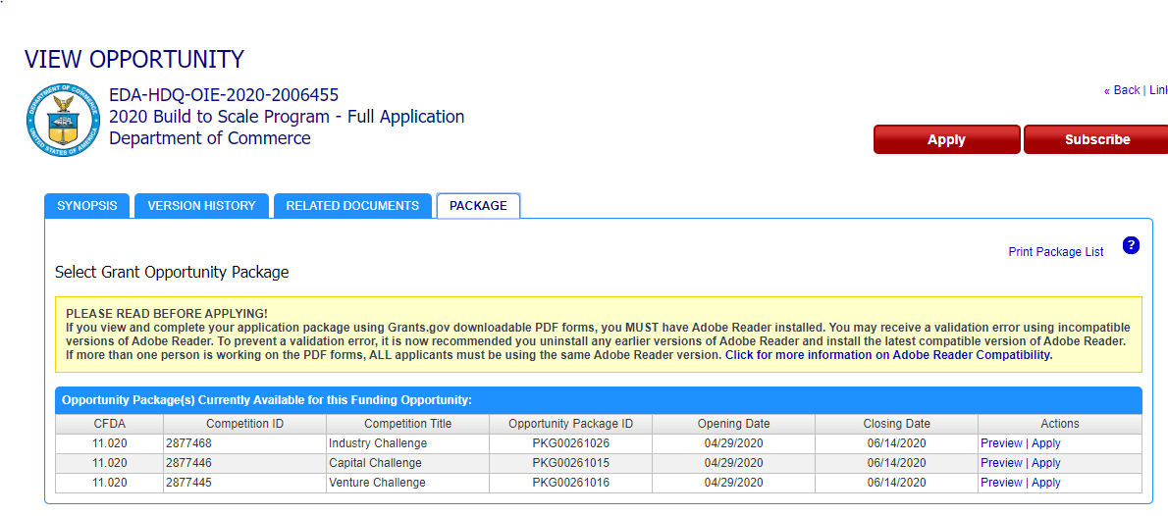

Slide 14
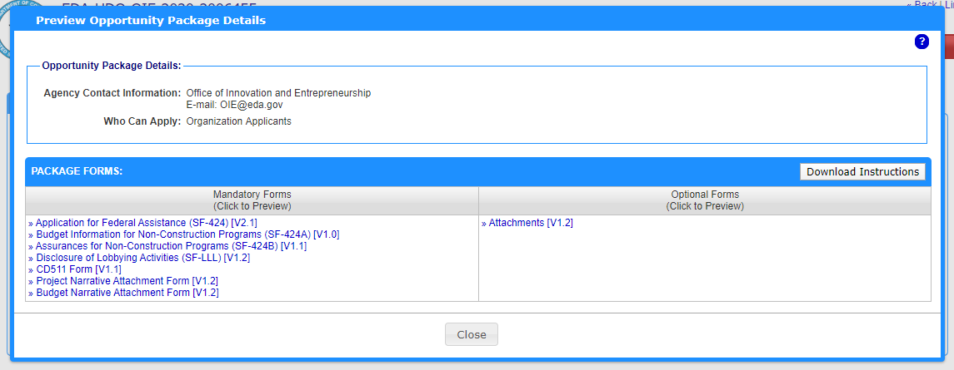

Slide 15



The Full Application
WHAT IS REQUIRED?
Review the information found in the FY2020 Notice of Funding Opportunity.

Slide 16
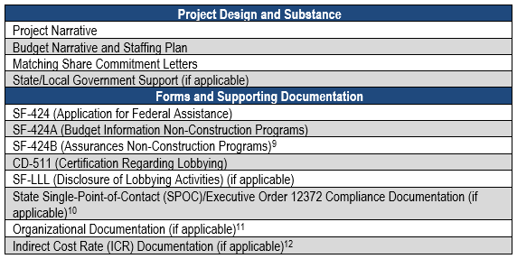
Full Application

Slide 17

Project Narrative
LIMIT OF 10 PAGES

Slide 18
Project Narrative
A competitive Full Application Project Narrative will...
  Be clear and concise
  Have a defined strategic gap it seeks to fill
  Include well defined partnerships - and roles of those partnerships
  Contain key milestones + dates
  Identify an achievable scope of work
  Demonstrate the long term potential impact (including metrics)

Slide 19

Budget Narrative + Staffing Plan
RECOMMENDED LIMIT OF 4 PAGES

Slide 20
Budget Narrative + Staffing Plan
A template has been made available for your use (Appendix B)
  Identify and justify how funds in each line item of the budget will be used to support the project
  Staffing plan listing all positions charged to the award
  Line items should distinguish between federal and match shares
  Budget categories should match SF-424A
  Itemized valuation for in-kind funds

Slide 21

Match Commitment Letters
MATCH MAY BE CASH, IN-KIND, OR A COMBINATION

Slide 22
Match + Match Commitment Letters
Match may be cash, in-kind or a combination of both
  Match must be committed, available, and unencumbered – and directly connected to the project
  If in-kind, should show how the valuation was derived
  Signed commitment letters are required
  Should be traceable to the budget narrative

Slide 23

Government Support
RELATED TO THE PROJECT SERVICE AREA
For non-governmental entities

Slide 24

PUTTING IT ALL TOGETHER
Review Criteria
SEVEN EQUALLY WEIGHTED CATEGORIES

Slide 25
REVIEW CRITERIA
1
2
3
4
CHALLENGE & OPPORTUNITY
PROPOSED SOLUTION
TARGET PARTICIPANTS
PARTNERS
Are partners and their roles within the proposal clearly identified and realistic to the proposal? Are the resources of the community and/or region being leveraged effectively?
Are the challenge and/or opportunity clearly stated, and are they aligned with the community or region’s needs? Is the region of service
clearly defined?
Is the solution aligned with the opportunity? Is the proposed solution achievable, and/or can substantial progress be made?
Does the proposal
address a specific stakeholder group or groups? Are these stakeholders in need
of the proposed solution?
footer

Slide 26
REVIEW CRITERIA
5
6
7
BUDGET & TEAM
IMPACTS
SUSTAINABILITY
Does the proposal clearly identify the financial, human, and
programmatic resources that will support the successful execution of the proposal?
Are there proposed outputs and outcomes measurable? Do they
seem reasonable and achievable in the grant period and beyond?
Are you confident this project will continue post-award?
Does the application demonstrate this effectively?

Slide 27



NEXT STEPS
WHAT'S NEXT FOR BUILD TO SCALE?
APRIL 29 TO JUNE 14
JULY TO SEPTEMBER
FALL 2020
Full Application window is open
Reviews + processing
Announcement of FY2020 Build to Scale Grantees

Slide 28
Additional Funding Opportunities
SBA
- Enterprising Women of Color
- Inner City Innovation Hubs
- Entrepreneurship Education Program for Formerly Incarcerated Persons
https://www.grants.gov/web/grants/search-grants.html?keywords=mbda
Micro-enterprise Investment and Technical Assistance
https://www.grantsolutions.gov/gs/preaward/previewPublicAnnouncement.do?id=67214
State Trade Expansion Program (STEP)
https://www.grants.gov/web/grants/view-opportunity.html?oppId=324277

Slide 29
Thank you
QUESTIONS?
eda.gov/oie/contact

