Slide 1
Southwest Regional
University Center Showcase
March 9th 2017

Slide 2
In this presentation..
EDA’s UC Program and 2018 Application
2017 Continuation
Post Approval
Notes:
EDA provides grants to state and local government, Indian tribes, Economic Development Districts, public and private non-profits, universities and other institutions of higher education to support the development and implementation of economic development strategies for economically distressed communities.
EDA’s goal is to encourage private capital investment in the nation’s most economically distressed regions, thereby creating and retaining higher-skill, higher-wage jobs

Slide 3


EDA’s mission is to lead the federal economic development agenda by promoting innovation and competitiveness, preparing American regions for growth and success in the worldwide economy.
As the only federal agency with economic development as its exclusive mission, EDA drives collaborative regional economic development initiatives that lead to job creation.
Notes:
EDA provides grants to state and local government, Indian tribes, Economic Development Districts, public and private non-profits, universities and other institutions of higher education to support the development and implementation of economic development strategies for economically distressed communities.
EDA’s goal is to encourage private capital investment in the nation’s most economically distressed regions, thereby creating and retaining higher-skill, higher-wage jobs

Slide 4
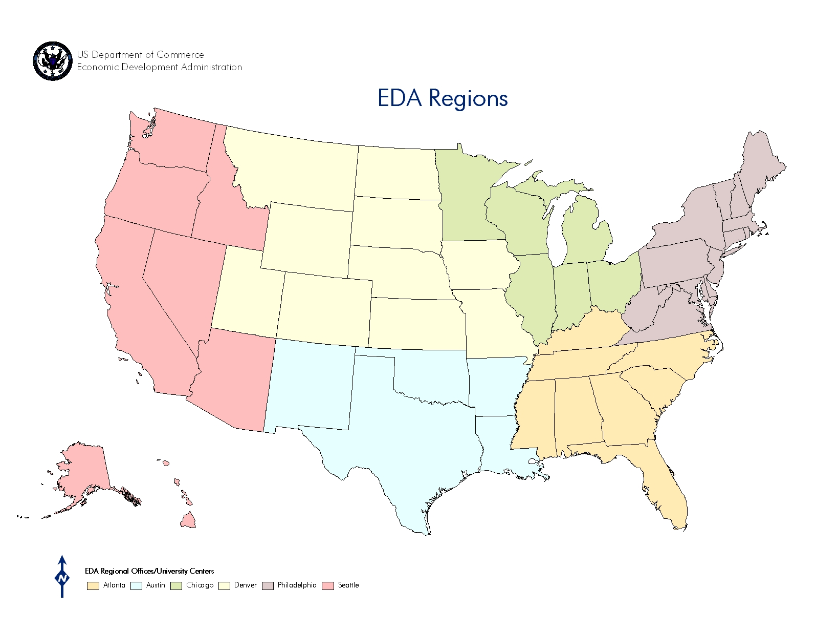
Seattle
Philadelphia
Denver
Chicago
Atlanta
Austin

Slide 5



EDA Investment Priorities
★ Collaborative Regional Innovation
★ Public/Private Partnerships
★ National Strategic Priorities
★ Global Competitiveness
★ Environmentally-Sustainable Development
★ Economically Distressed and Underserved Communities

Slide 6
EDA University Center Program
Five-year grant period
Accredited institution of higher education
Focus on advancing regional commercialization efforts, entrepreneurship, innovation, business expansion in a region’s innovation cluster(s), and a high-skilled regional workforce
Between $80,000 – $200,000
Currently funding 10 UCs at ~$100,000
Application expected to be open Jan-Mar 2018 http://www.grants.gov/

Slide 7
2017 Continuation
March (ongoing) – EDA Review of Current UCs
March 31 – Request for UC Application Materials:
  Any changes to project/scope
  Budget
  Match letter
  Standard Forms and Assurances
April 15 – UC Application Materials Due
July – Processing Complete

Slide 8
Post Approval
Reporting Changes:
  All reports to be submitted via email for remainder of grant period due Feb 28 and Aug 31
    Narrative Report
    Financial Report SF-425
    GPRA
  Will transition to GrantsOnline in 2018 cycle
Payment Requests
  Draw down from earliest grant first
  Draw down in proportion to your grant rate

