Slide 1

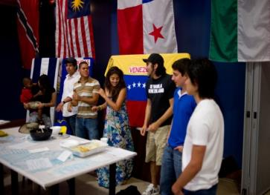


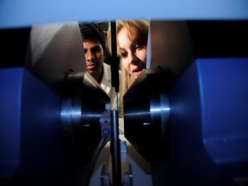
THIS IS
LOUISIANA TECH
UNIVERSITY
Achieving national-scale impact for our region

Slide 2

Cyber Storm 2016

Slide 3

“PARTNERSHIP SPOTLIGHT”
Cyber Storm 2016
  Louisiana Tech faculty have created Cyber Storm – a competition that serves as final exam for selected courses in the cyber engineering and computer science programs, and tests the student’s ability to prepare, anticipate and react to a variety of real-time threats and scenarios. It has attracted the interest and
  active participation of a number of public and private partners.

Slide 4
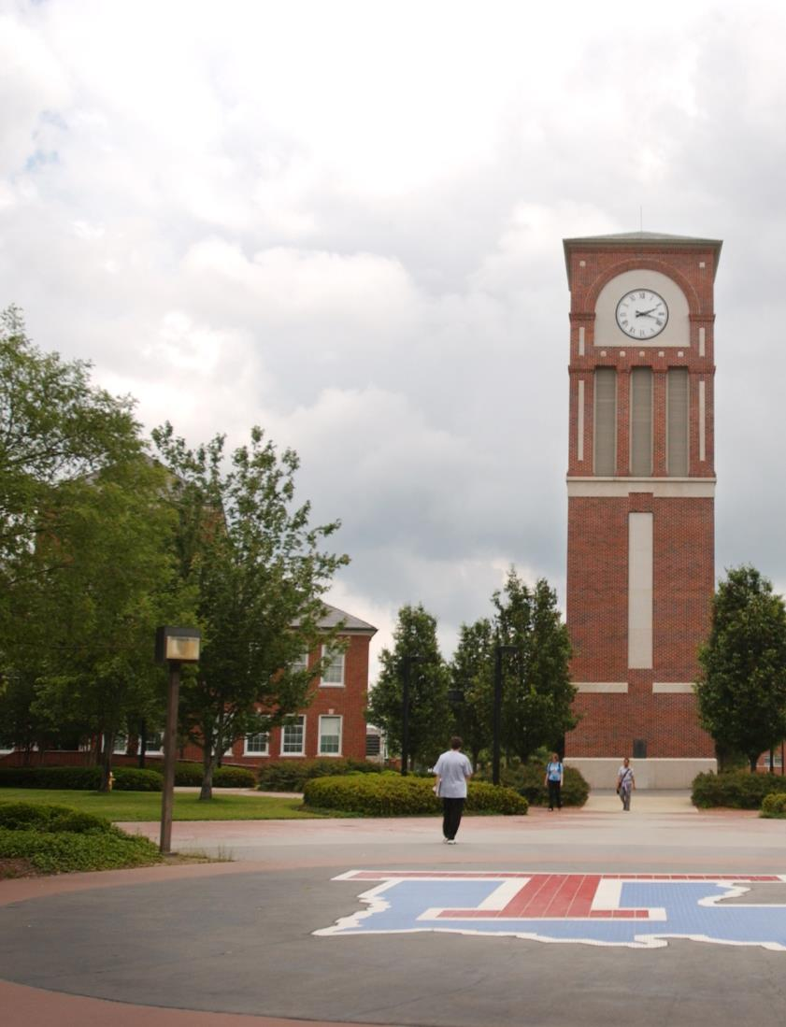

Achieving national-scale impacts for NLA
  Economic conditions in North Louisiana in 2005
  Higher Education in North Louisiana in 2005
  Other regional/state developments
  Strategic Planning
  Pivotal role of EDA
  Louisiana Tech and North Louisiana in 2017
  Keys to success
Strategic Progress 2013-2014

Slide 5


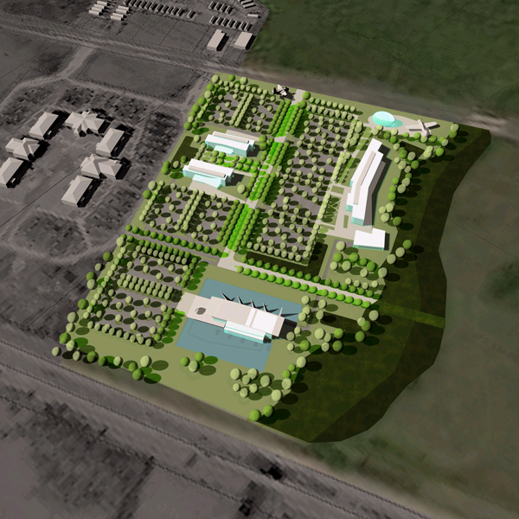
National Cyber Research Park
3,000 Acre Overlay District
Phase I – 64 Acres
CSRA’s Integrated Technology Center
Future
BPCC STEM Building
Louisiana Tech Research Institute

Slide 6

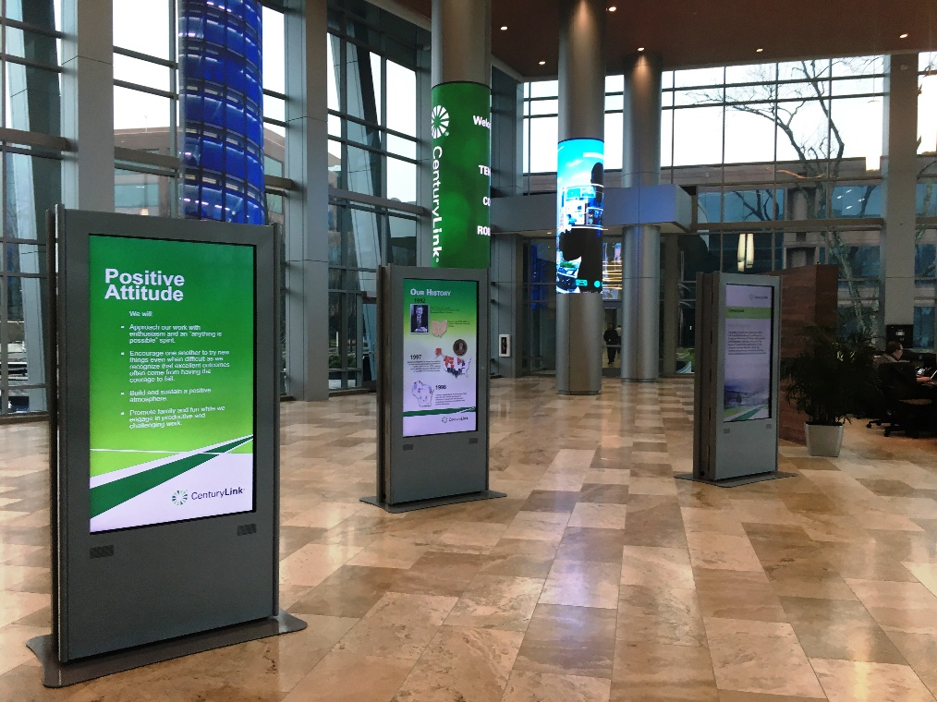

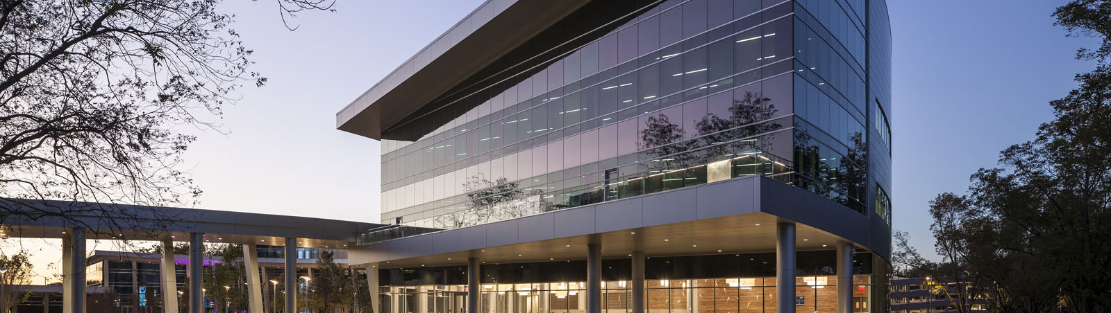

Slide 7
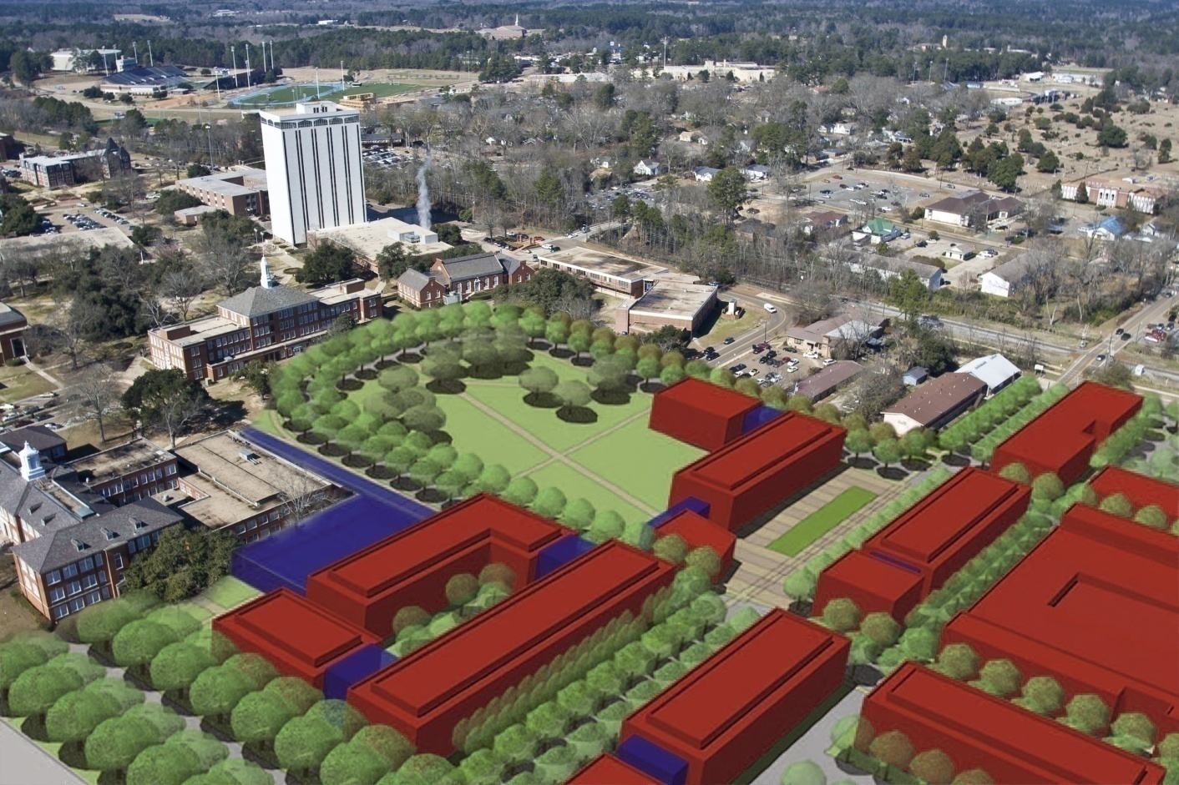


Slide 8
Achieving national-scale impacts for NLA
  Economic conditions in North Louisiana in 2005
  Higher Education in North Louisiana in 2005
  Other regional/state developments
  Strategic Planning
  Pivotal role of EDA
  Louisiana Tech and North Louisiana in 2017
  Keys to success
Strategic Progress 2013-2014

Slide 9
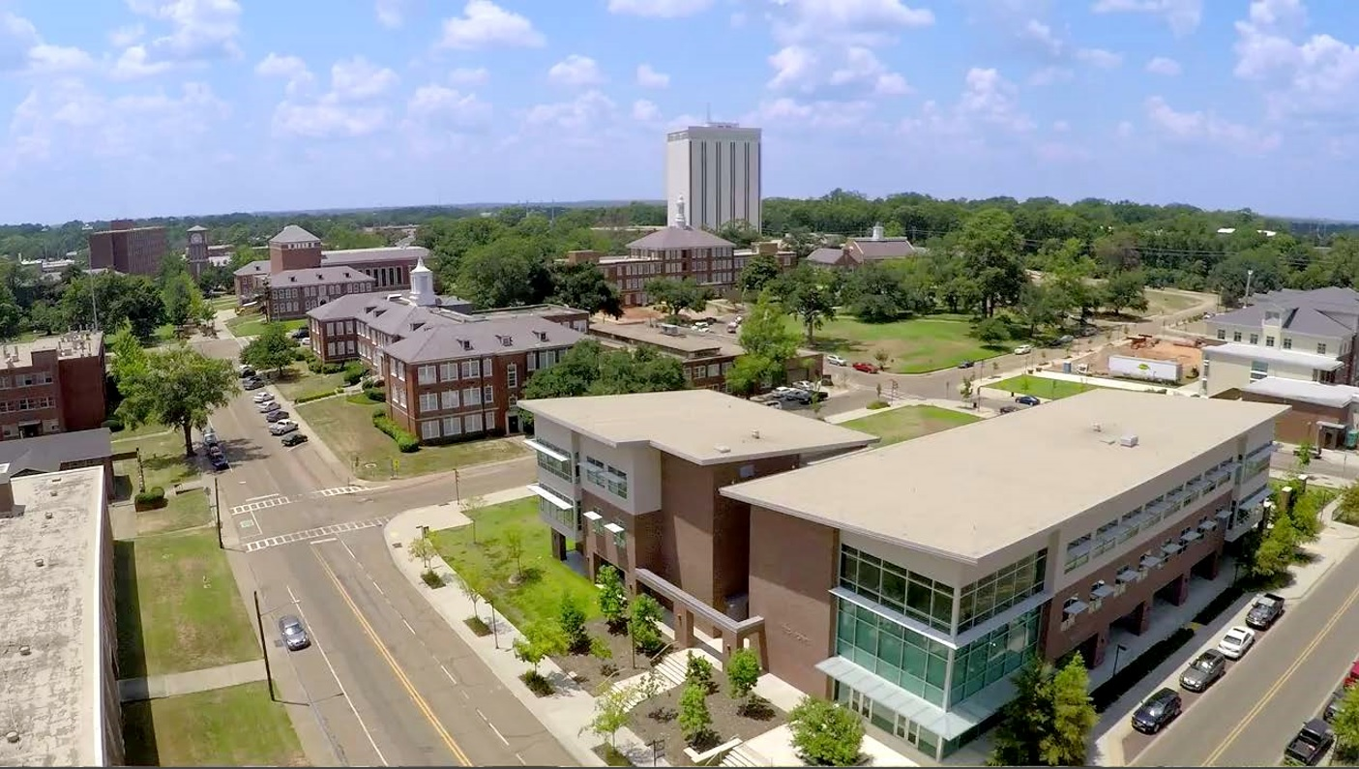

Slide 10

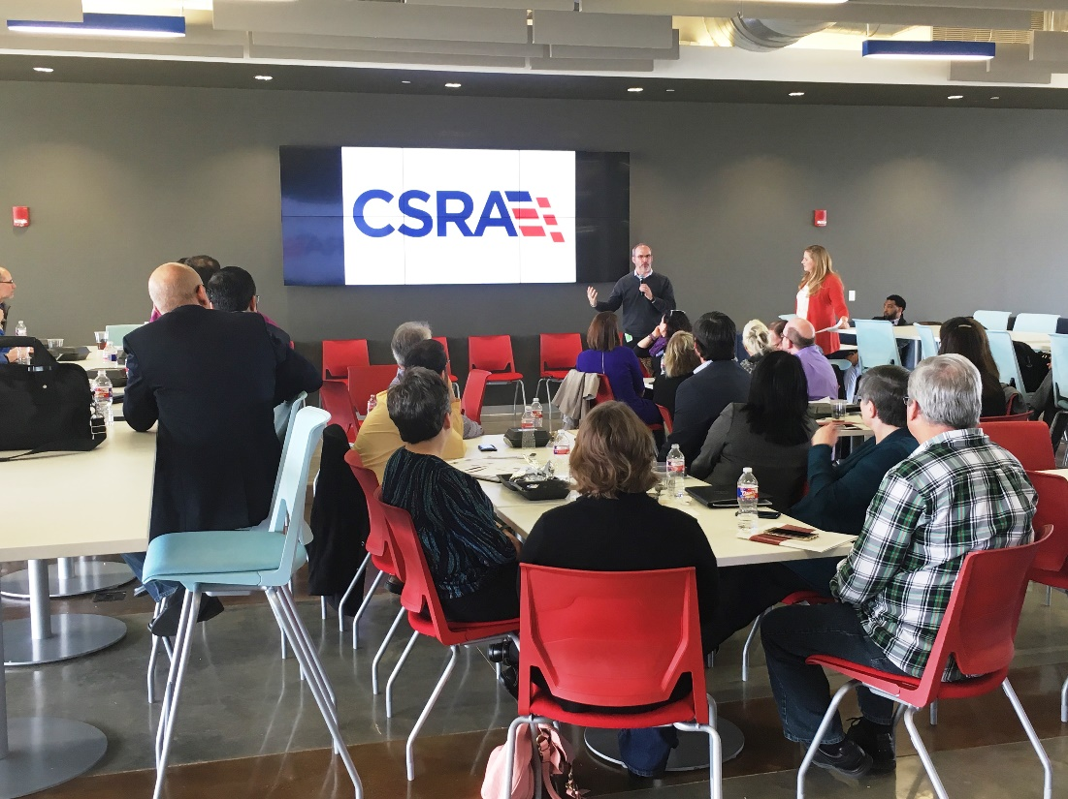
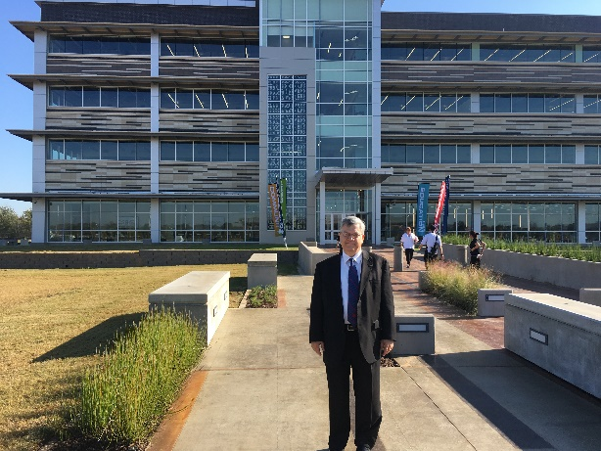
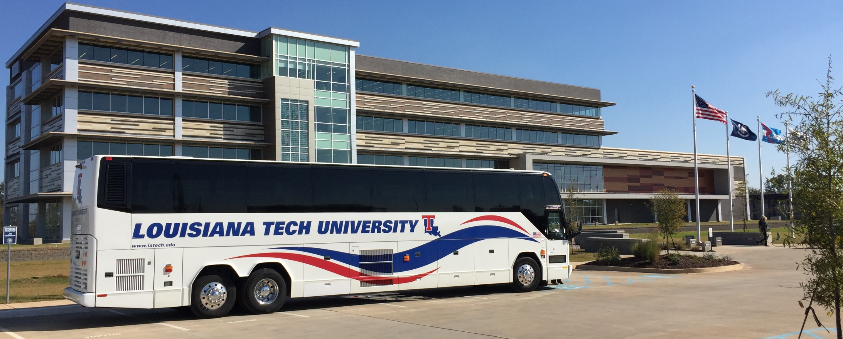

Slide 11


Slide 12
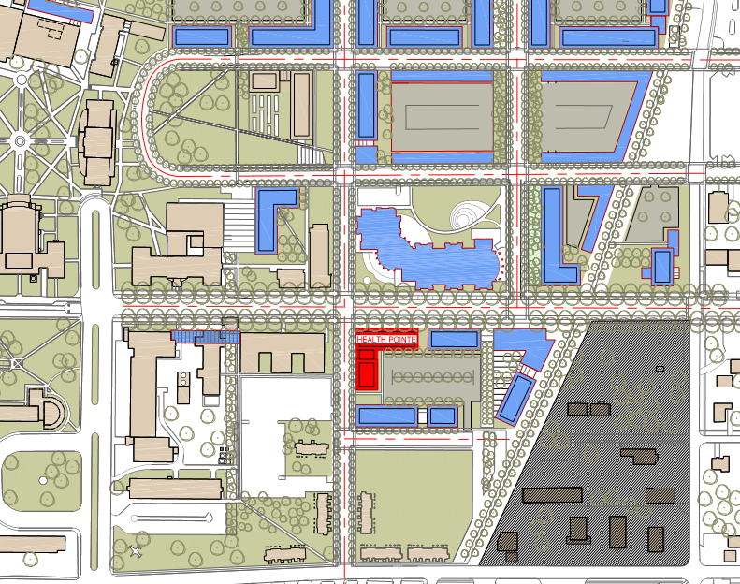

Slide 13
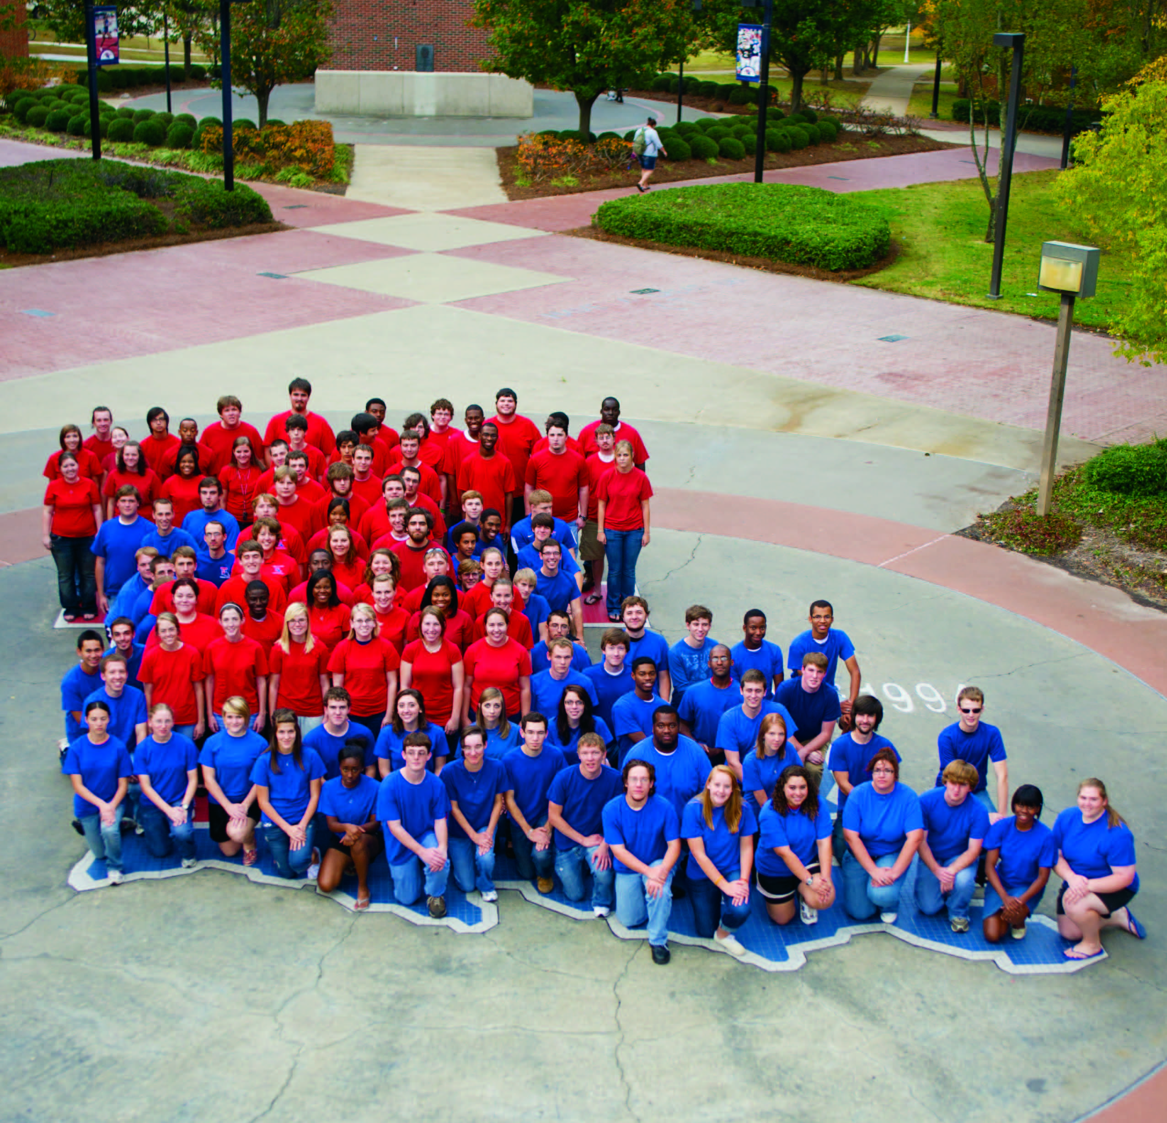
Thank You
for Visiting
LOUISIANA
TECH
UNIVERSITY

Slide 14
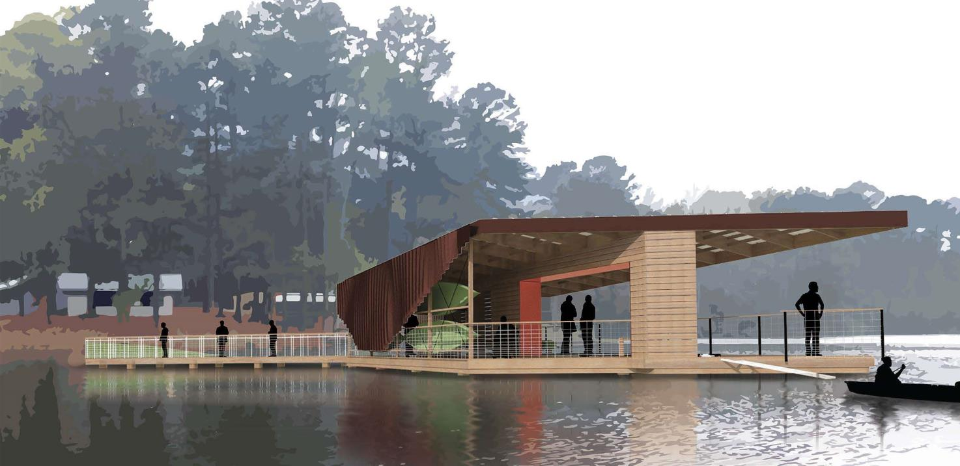
“UNPARALLELED EDUCATION SPOTLIGHT”
MedCamps and School of Design
  “Rebuilding MedCamps” showcases the work of the School of Design and the partnership with MedCamps of Louisiana, an organization that provides free summer camp experiences to children with chronic illnesses and disabilities. Students learn that education outside the traditional classroom is not only worthwhile, but inwardly meaningful and outwardly powerful, and
  that the experience can represent compassion and
  service that fuel future generations of students.

Slide 15
School of Design & MedCamps

