Slide 1
Southwestern Oklahoma State University (SWOSU)
Business Enterprise Center
Doug Misak
Director

Slide 2
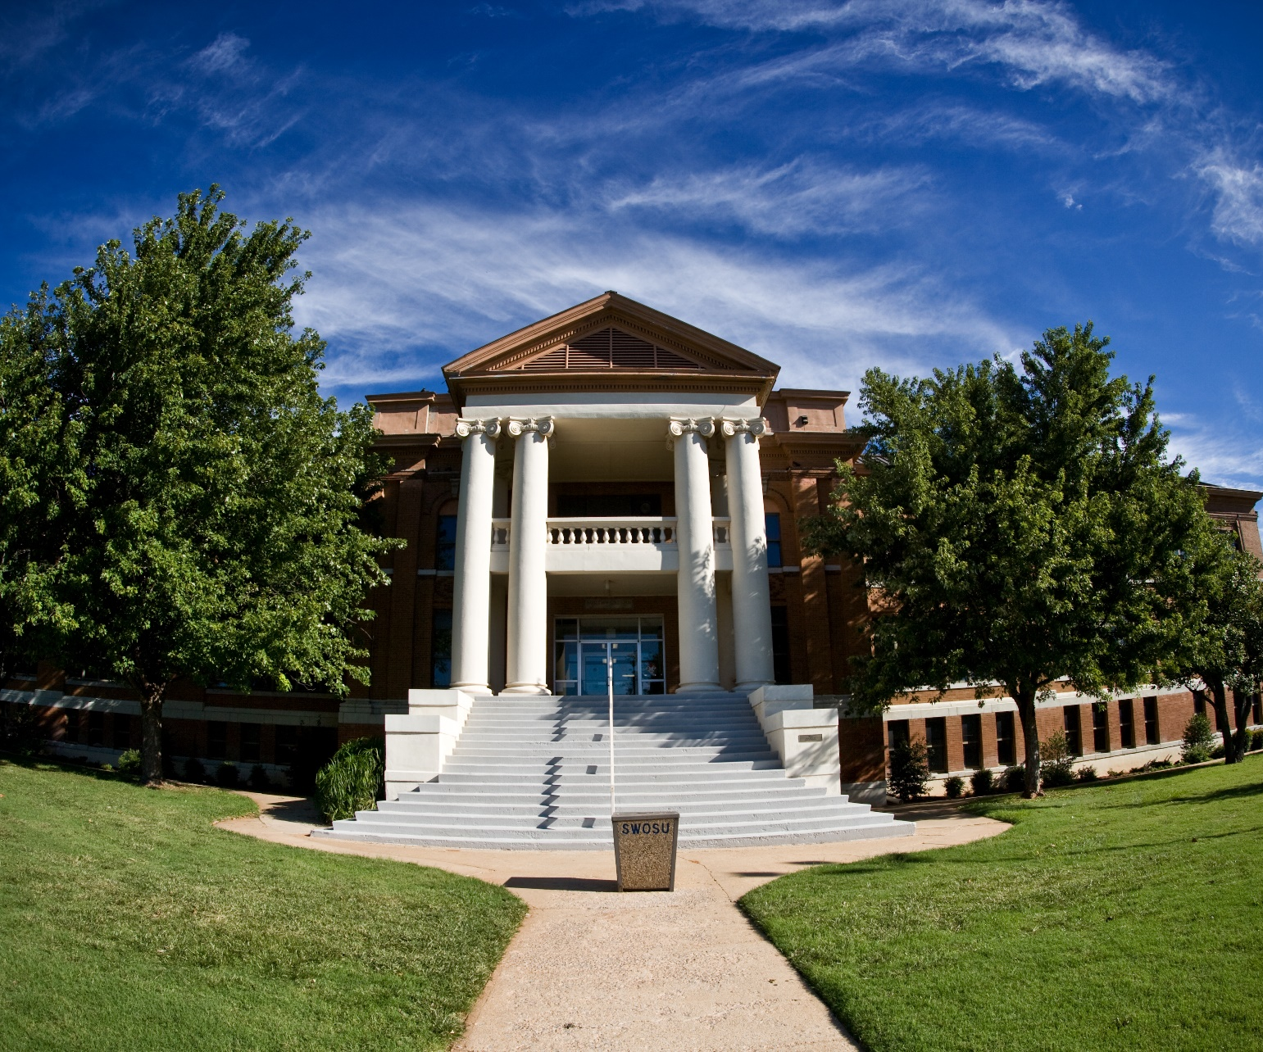
SWOSU
Regional University
5,000₊ students
Top Programs
  Pharmacy
  Nursing
  Education
  Business

Slide 3
E-synchronist Identified Needs
  Skilled Workforce
  Wireless Connectivity
  Medical Care
  Water Resources
  Child Care
  Roads, Highways, and Transportation
  Electrical Services
  Workers Compensation

Slide 4
Southwest Oklahoma Impact Coalition (SOIC)
5 Universities and Colleges
  Cameron University
  Redlands Community College
  SWOSU
  University of Science and Arts of OK
  Western OK State College
2 Workforce Investment Boards
  Association of South Central OK Governments
  South Western OK Development Authority

Slide 5
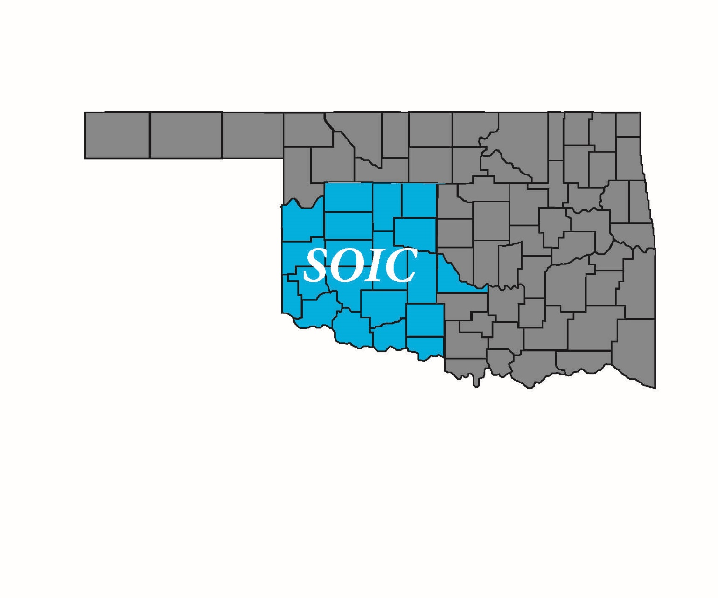
SOIC
20 County Region
26% of Oklahoma
17,919 sq. miles
588,191 population (2015)
Hosts two major military installations
State-designated spaceport
7 Native American Indian Tribal Government Centers

Slide 6
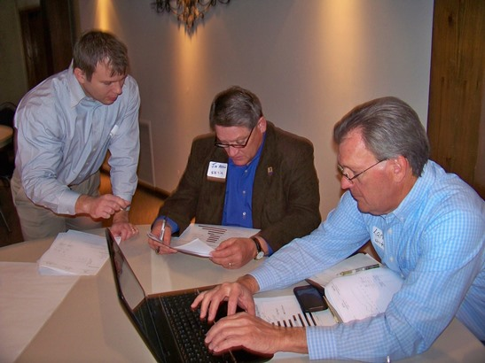
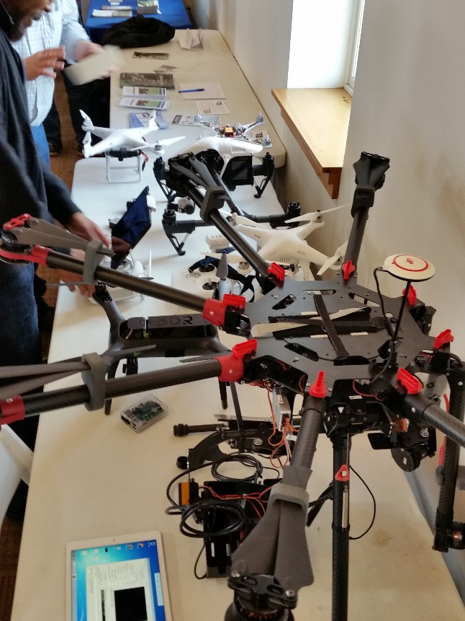
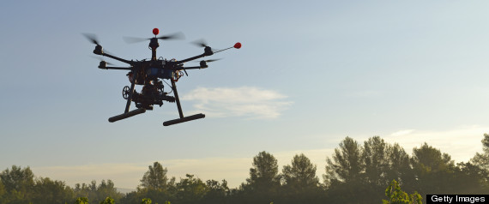
Goal 1: Re-establish and expand aerospace industry.
Unmanned Aerial Systems
The Oklahoma Spaceport

Slide 7
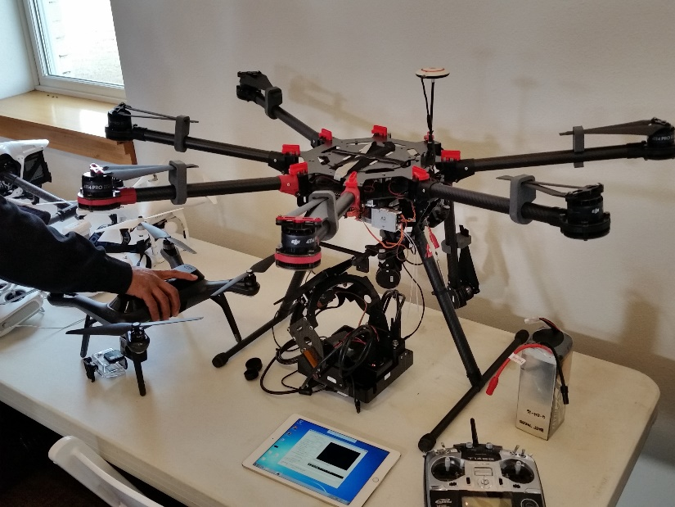
Goal 1: Re-establish and expand aerospace industry.
Association of Unmanned Vehicle Systems International recently released a report that found precision agriculture and conservation could account for 90 percent of civilian drone use by 2020.
Rural Electric Cooperative
$50,000 savings/year
Storm damage assessment
Railroads
Just beginning
Track lines and bridges

Slide 8
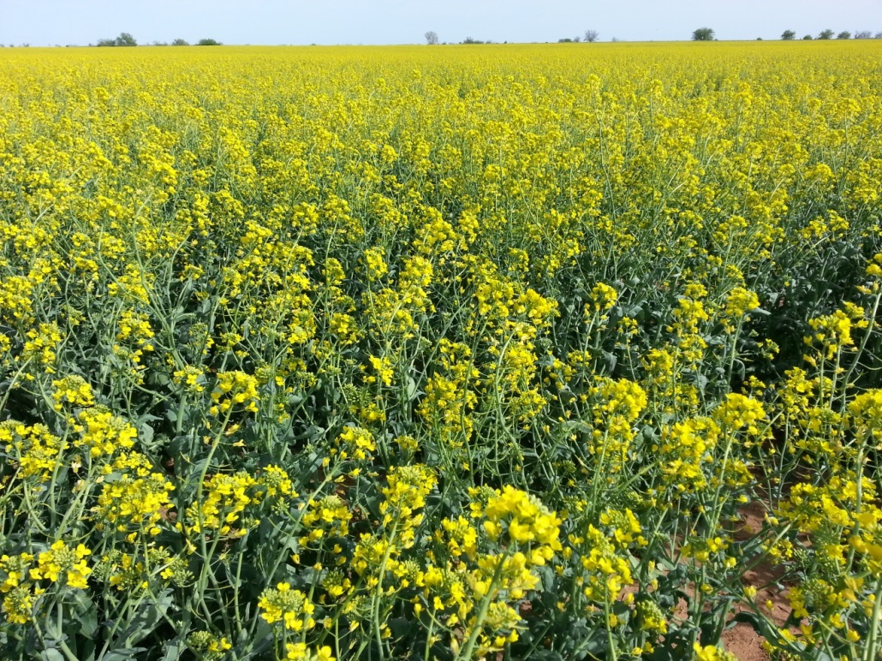
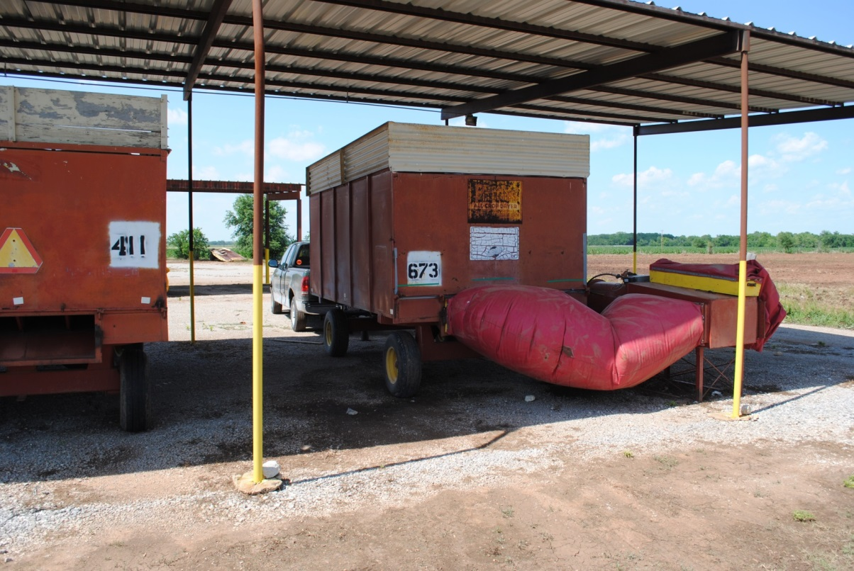
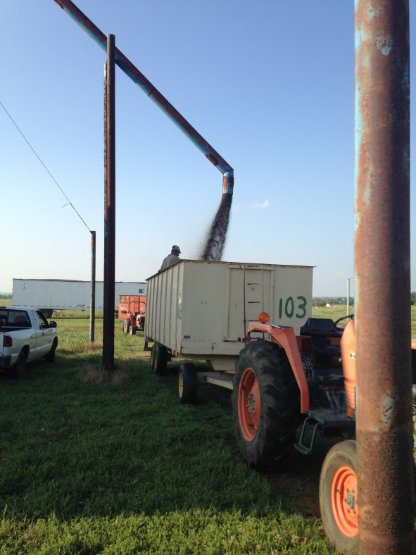
Goal 2: Create diversified agriculture and value-added products
$7M increase in canola production

Slide 9
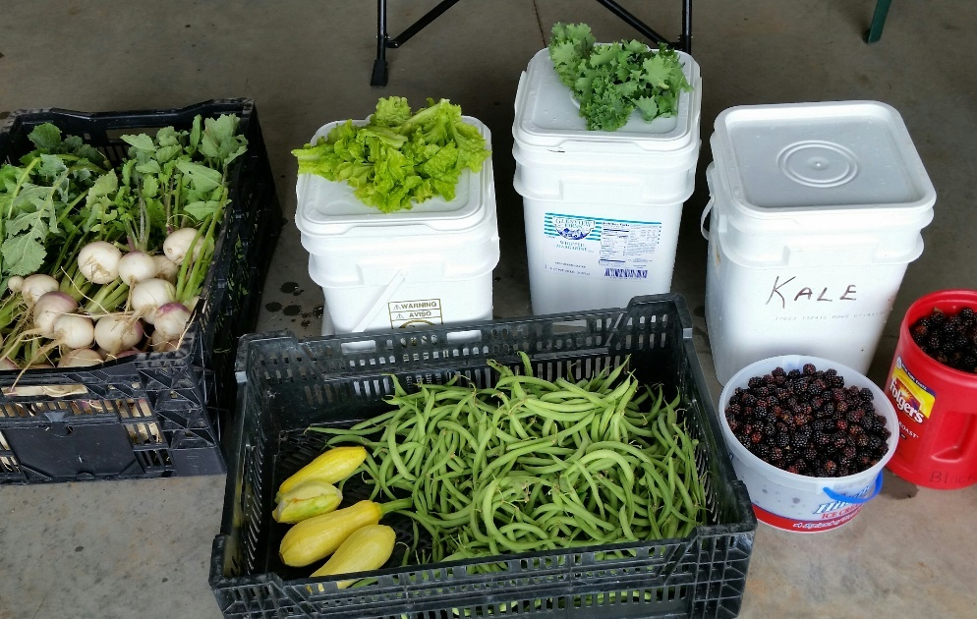
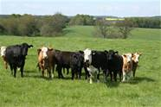
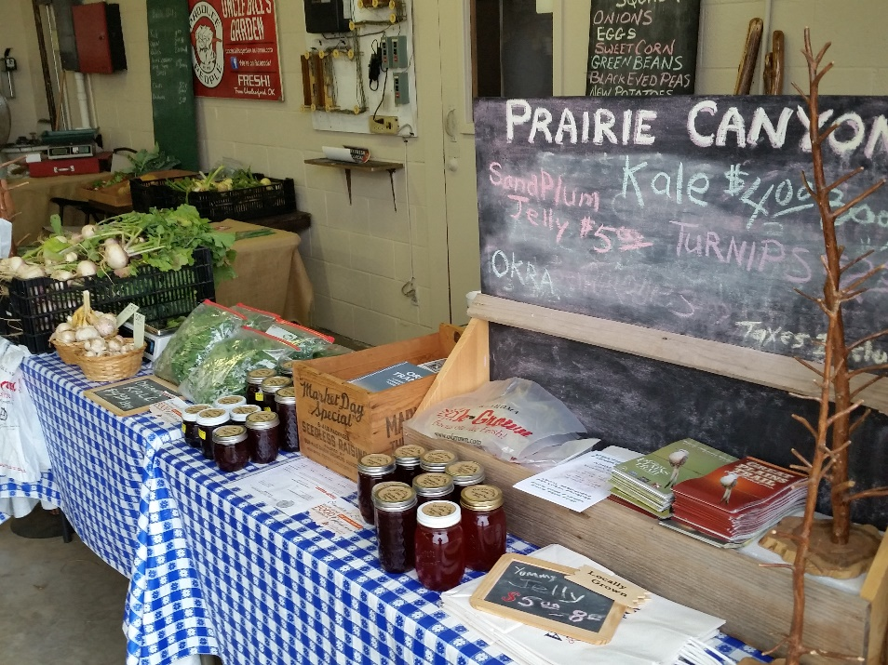
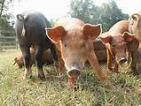
Goal 2: Create diversified agriculture and value-added products

Slide 10
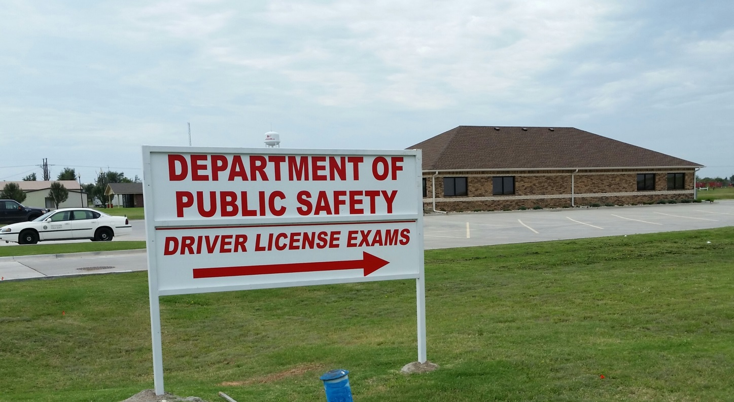
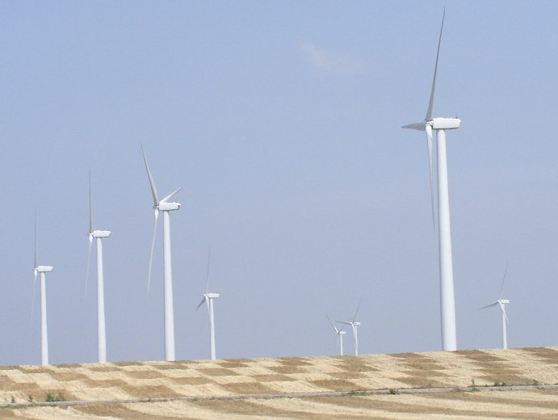
Goal 3: Expand energy sector through diversification and recruit administration.
Filling jobs – CDL Class A licensing facility built in area

Slide 11
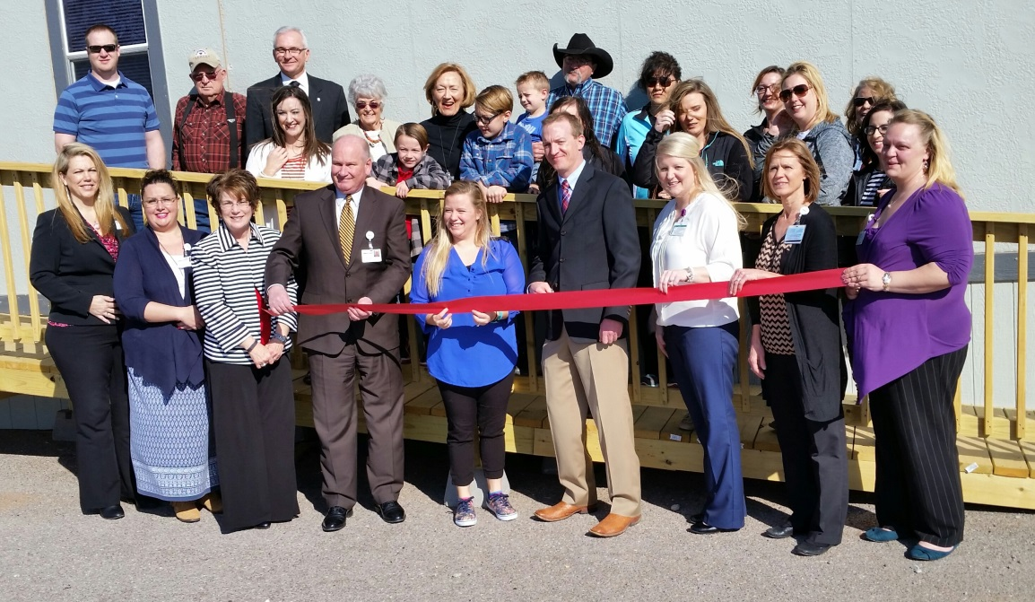
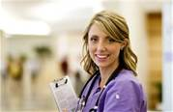
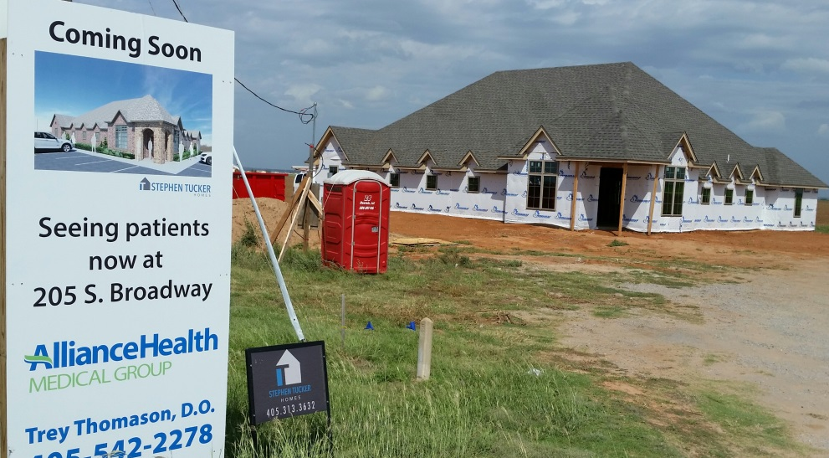
Goal 4: Improve healthcare facilities, staffing, and technology.
Recruit doctors to rural areas
Home health care assistants and RNs
SWOSU graduates 100% BSN

Slide 12
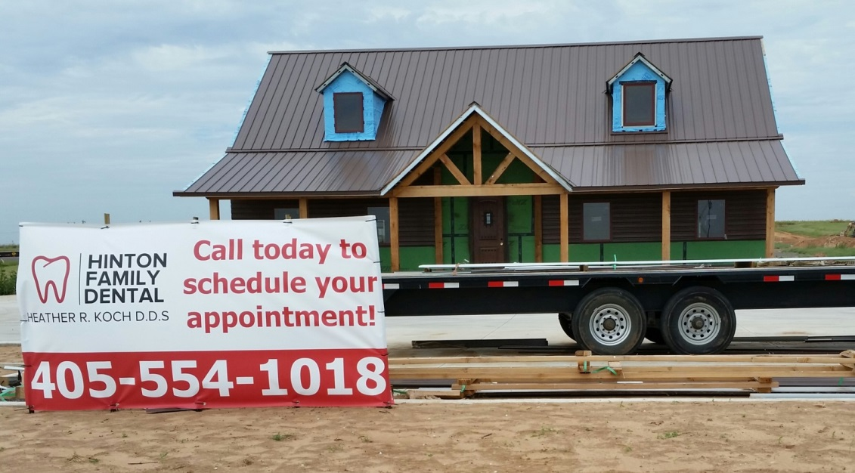
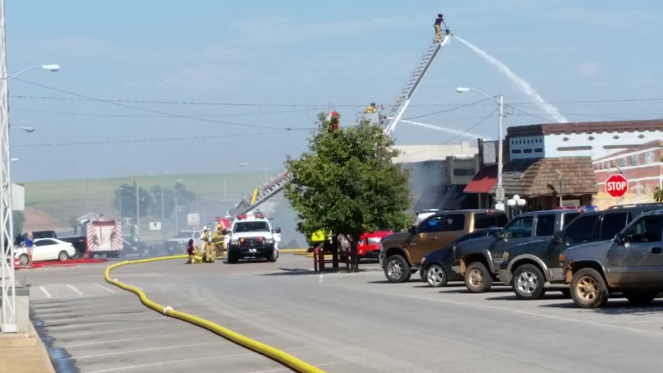
Goal 4: Improve healthcare facilities, staffing, and technology.
New convenient care facilities
Express Wellness centers
Cordell Hospital – telemedicine
Sayre – hospital closed
New Dentist Office

Slide 13
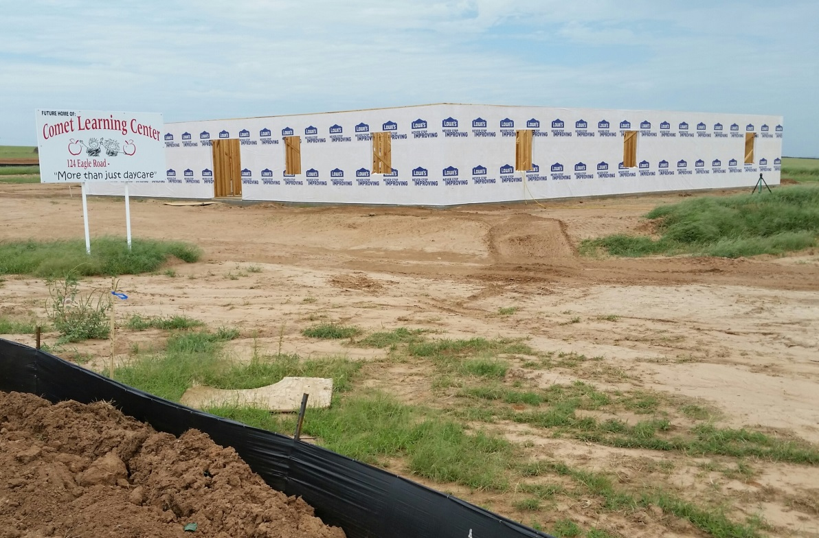
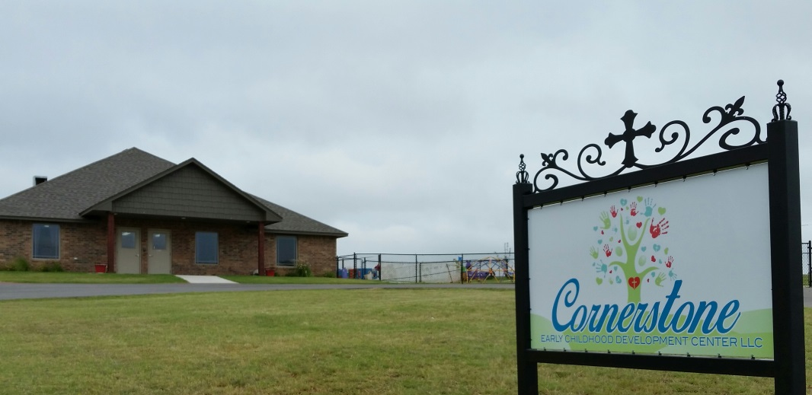
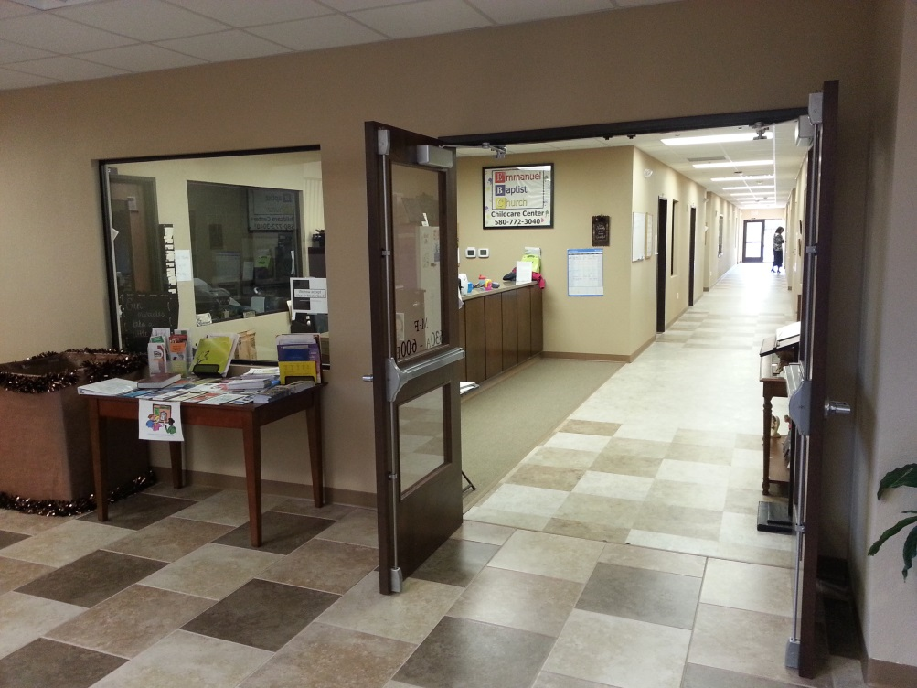
Goal 5: Develop amenities that will support strong community lifestyles.
Childcare Facilities
Weatherford 2
Anadarko 1
Hinton 1
Thomas 1

Slide 14
Student Intern Program
Funding
Benefits to students
Economic Development Administration
SWOSU
Private Sector Donations
Employing Businesses
Real World Experience
Paid $10.25 - $12 Per Hour
Multi-Disciplinary: Accounting, Finance, Management, Marketing, Entrepreneurship, Engineering Technology, Graphic Design, English, Journalism, Computer Science

Slide 15
Intern Project:
Construction of modular artificial nucleases with macrocycle metal ligands and variable DNA binding domains (Molecular Scissor Project)
Sequojah O’Neal-Johnson
Optimizing a new technique to analyze the activity of different metal complexes to cut DNA in real time
Metal complexes will be the sharp part of the molecular scissors

Slide 16
Intern Project:
Construction of modular artificial nucleases with macrocycle metal ligands and variable DNA binding domains (Molecular Scissor Project)
Megan Oertel
Investigating DNA sequence specificity of different metal complexes
Will compare how well the sharp part of the scissors cut if we try to cut different weights of paper for different materials
Believe that the DNA sequence should not matter, but have to show that before they can start designing the handles of the scissors

Slide 17
Intern Project:
Construction of modular artificial nucleases with macrocycle metal ligands and variable DNA binding domains (Molecular Scissor Project)
Presented their findings
Oklahoma Research Day (Oklahoma City)
SWOSU Research & Scholarly Activity Fair (Weatherford, OK)
American Chemical Society Conference (San Diego, CA)
  10,000+ chemists from around the world attended

Slide 18
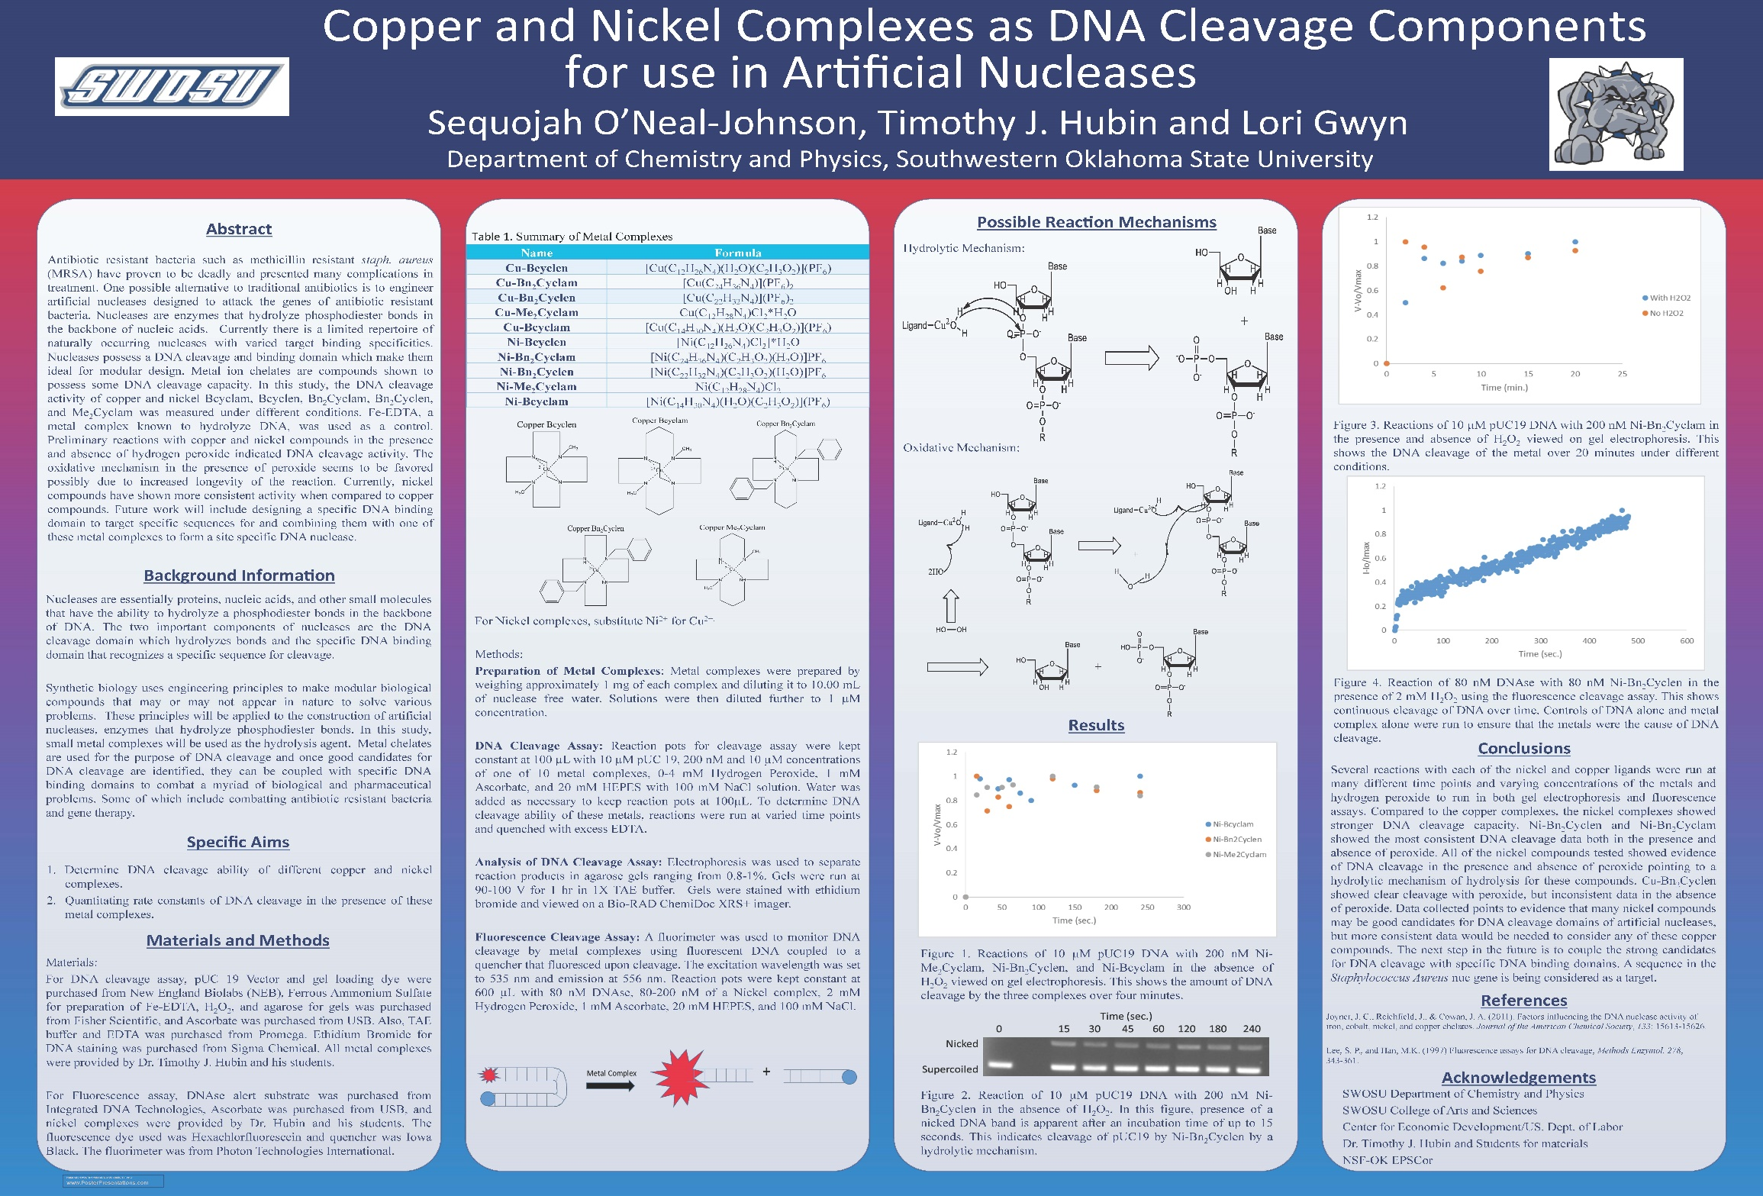

Slide 19
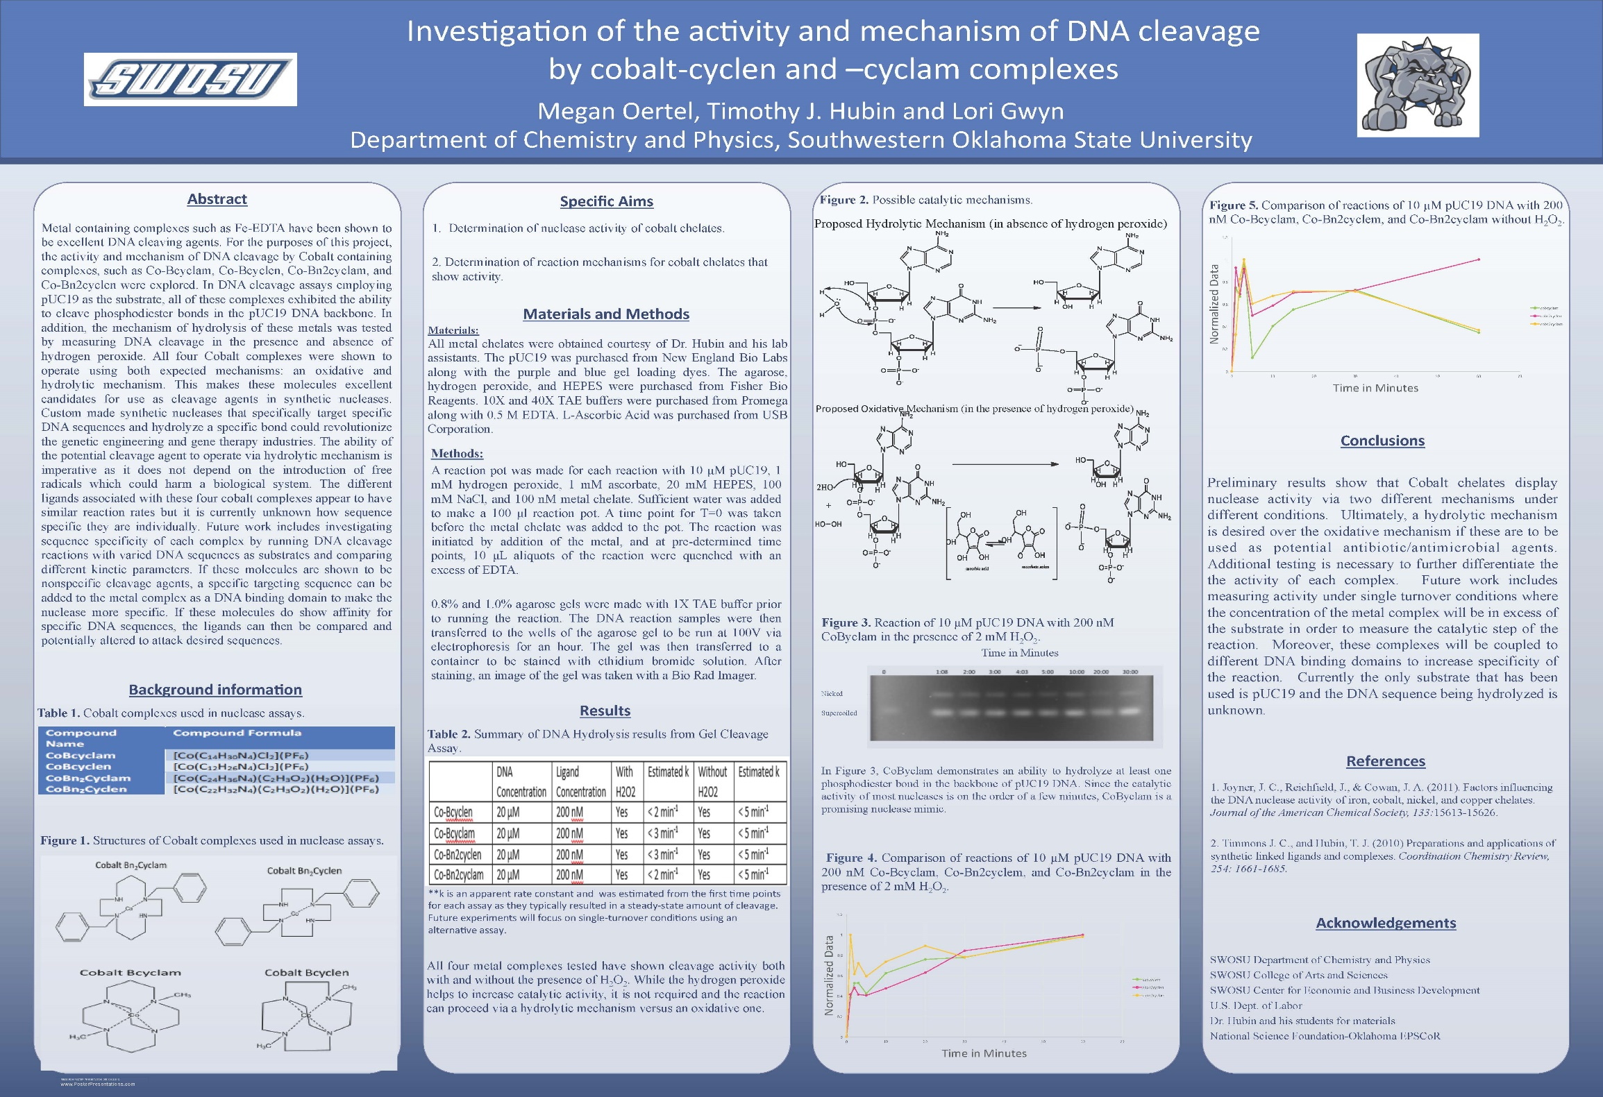

Slide 20
Intern Project: Synthetic Biology Project
Madison Duckwall
Synthetic Biology
  Engineering principals are applied to biological systems to make new tools
Working to make an arsenic biosensor and bacteria that will make aspirin
Successful in making biosensor, but it is always turned “on” under all environmental conditions
Working to make sure it is only turned “on” in the presence of arsenic

Slide 21
Challenges, Setbacks, and What Comes Next
Key Challenges
  Large geographic area (18,000 square miles) require extensive team building and asset mapping
  What’s Next?
  SOIC – self sustaining?
  GIS Mapping
Setbacks and Lessons Learned
  Set too many goals initially
  Accountability for team members

Slide 22
Questions?
Email: doug.misak@swosu.edu
Southwestern Oklahoma state university
100 Campus Drive
Weatherford, OK 73096
580.774.7095
www.swosubec.com

