Slide 1

University Center for Regional Commercialization
March 8, 2017
2017 Austin Region EDA University Center Conference

Slide 2

CONTENT OVERVIEW
1
About Us
2
Needs & Program Solutions
3
Key Challenges
4
What’s Next

Slide 3

AHC INTRO SLIDE HERE

Slide 4



NEW MEXICO STATE UNIVERSITY
Land-grant institution
Total enrollment in Fall 2016: 27,520
Main campus in Las Cruces, NM
Four community colleges (three in rural communities)
Research expenditures in FY 2016: $110,118,461
Carnegie Foundation R2: Doctoral Universities - Higher
55% Hispanic student population
Carnegie Community Engagement Classification
Innovation and Economic Prosperity University

Slide 5
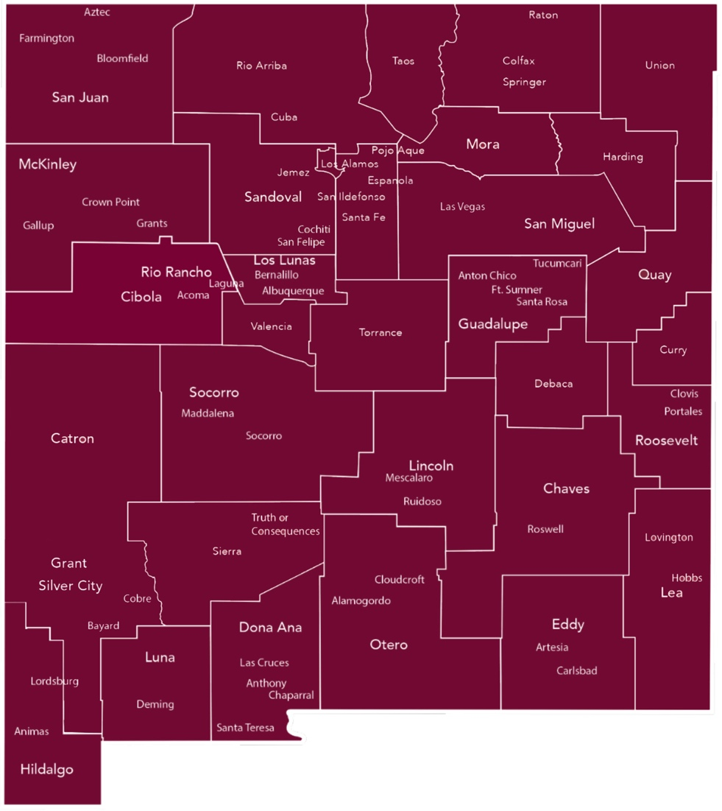
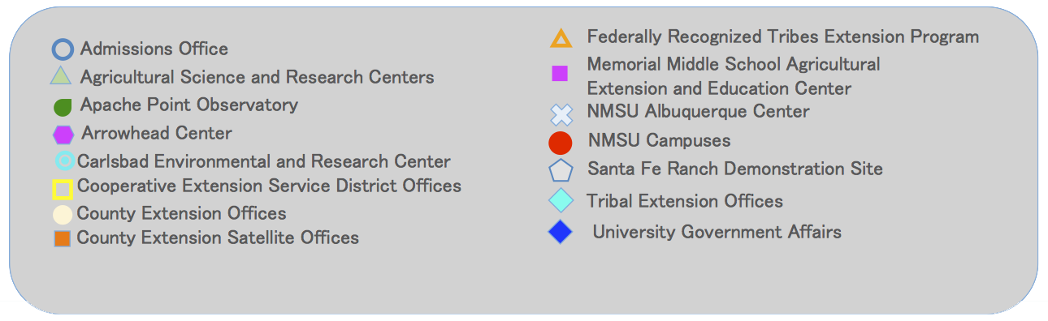
OPPORTUNITY FOR
DISCOVERY
STATEWIDE
NMSU has a presence in every county, serving a multicultural population through teaching, research and service

Slide 6

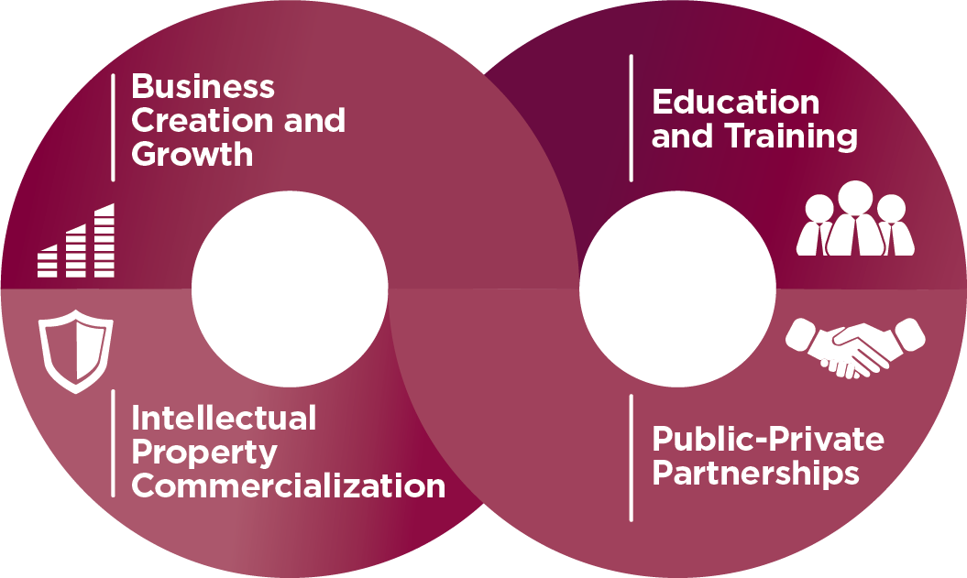
ARROWHEAD CENTER
Drive economic development through innovation and entrepreneurship
Build regional capacity by making available to individuals and firms the knowledge, skills, and resources they need to be successful in innovation-driven business development and entrepreneurship

Slide 7

UNIVERSITY CENTER FOR REGIONAL COMMERCIALIZATION
Accelerate innovation-based commercialization in NM through startup programs, entrepreneurship training, venture research, economic studies, and access to NMSU’s resources

Slide 8

Needs and Programs Solutions
SLIDE HERE

Slide 9

ECONOMIC LANDSCAPE
Low per capita income (45th among the 50 states, $37,605)
Below poverty rate (21.3%, higher than any other state except MS)
Low job growth rate (1-1.5%)
Slow recovery from 2008 recession
Dependence on oil and gas
High level of inventions and innovations
Low rate of transfer of innovations to the marketplace

Slide 10
REGIONAL NEEDS
Well-defined commercialization pathways
Startup capital
Startup founders
Best methodologies in entrepreneurial training
Networks of experts to support all phases of the commercialization process
Innovation & commercialization ecosystem gaps

Slide 11
PROGRAM SOLUTIONS
Add critical program elements to enhance commercialization statewide
  Deliver entrepreneurial training incorporating best practices
  Provide access to NMSU resources for commercialization
Expand existing commercialization programs to serve new and larger groups of beneficiaries
  Enhance acceleration and incubation programs
  Conduct research for new ventures
  Deliver economic studies and policy analyses

Slide 12

ENTREPRENEURIAL TRAINING
Trained UC staff on Design Thinking and Lean Startup
Offered training university-wide and statewide
Incorporated Design Thinking and Lean Startup into all programs
Success: Stimulated entrepreneurial thinking in underserved populations; supported a more inclusive environment; incorporated latest training methodologies
Work Remaining: Host workshops and events

Slide 13
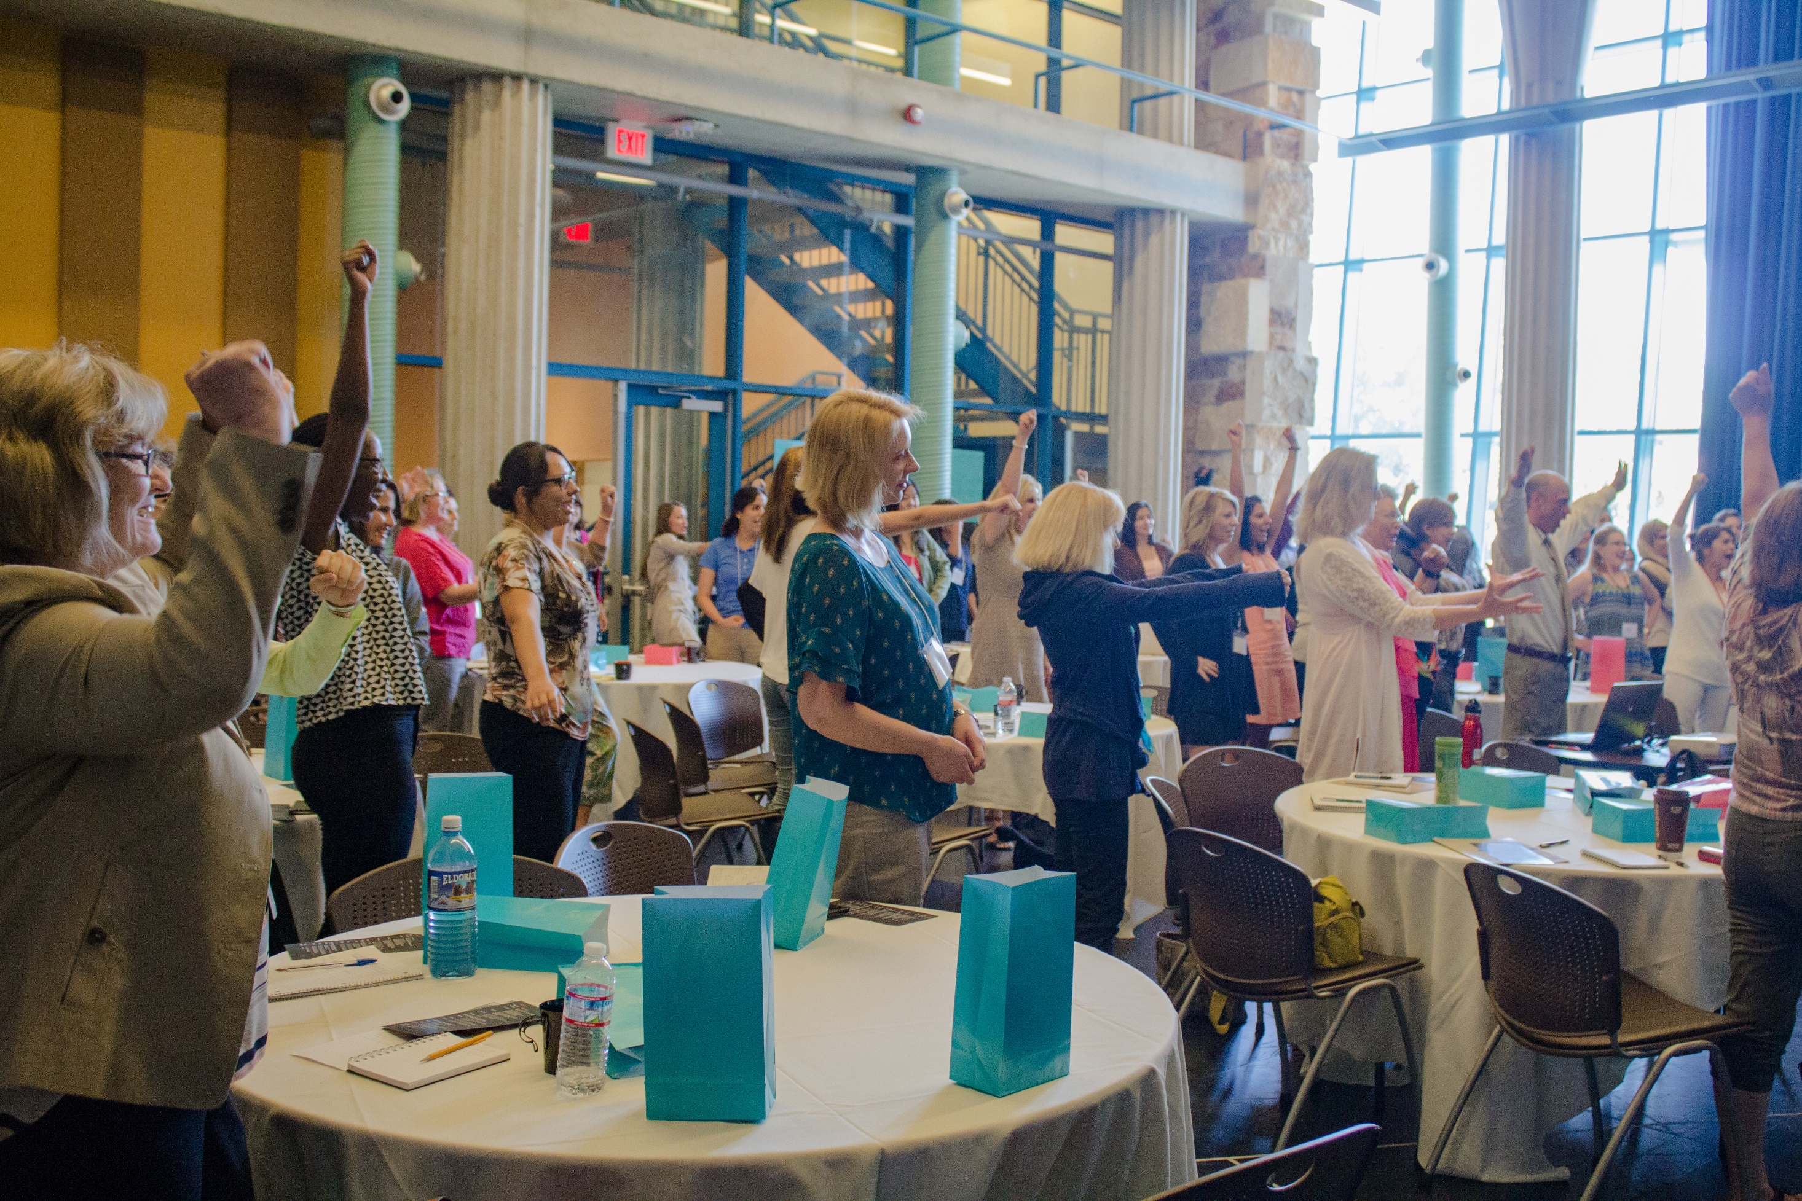

Slide 14

NMSU ASSETS
Launched a single NMSU website entry point for faculty expertise
Developed business-friendly contract templates
Promoted innovation resources
Grew number of faculty serving as enterprise advisors to startups
Developed TechMatch program to promote NMSU technologies
Success: Improved access to commercialization resources
Work Remaining: Streamline access to labs/facilities; strengthen collaboration with CES and research units

Slide 15

ACCELERATION PROGRAMS
Opened Launch to NMSU’s community colleges and alumni
Expanded ATI with StartupSprints: AgSprint, HealthSprint, TechSprint, ExportSprint
Grew Studio G network and program offerings
Added Kauffman Fellow to staff
Success: Expanded and strengthened commercialization programs and investments; strengthened tech clusters; created businesses and jobs
Work Remaining: Implement StartupSprints

Slide 16
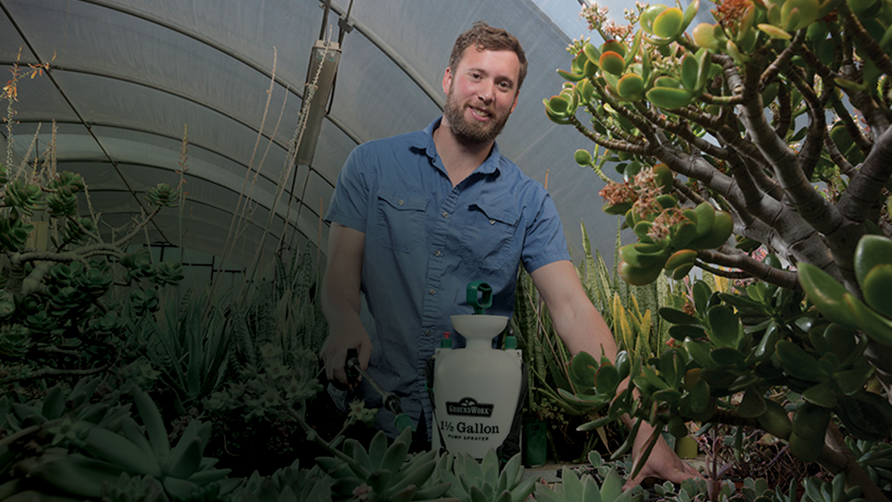
ECOSEAL
Organic pesticide
Licensed from NMSU
Company founder is a recent NMSU graduate
Validation testing in NM and CA
Initial funding from Launch ($15,000)
Follow on funding from NSF and State
of NM ($100,000)

Slide 17
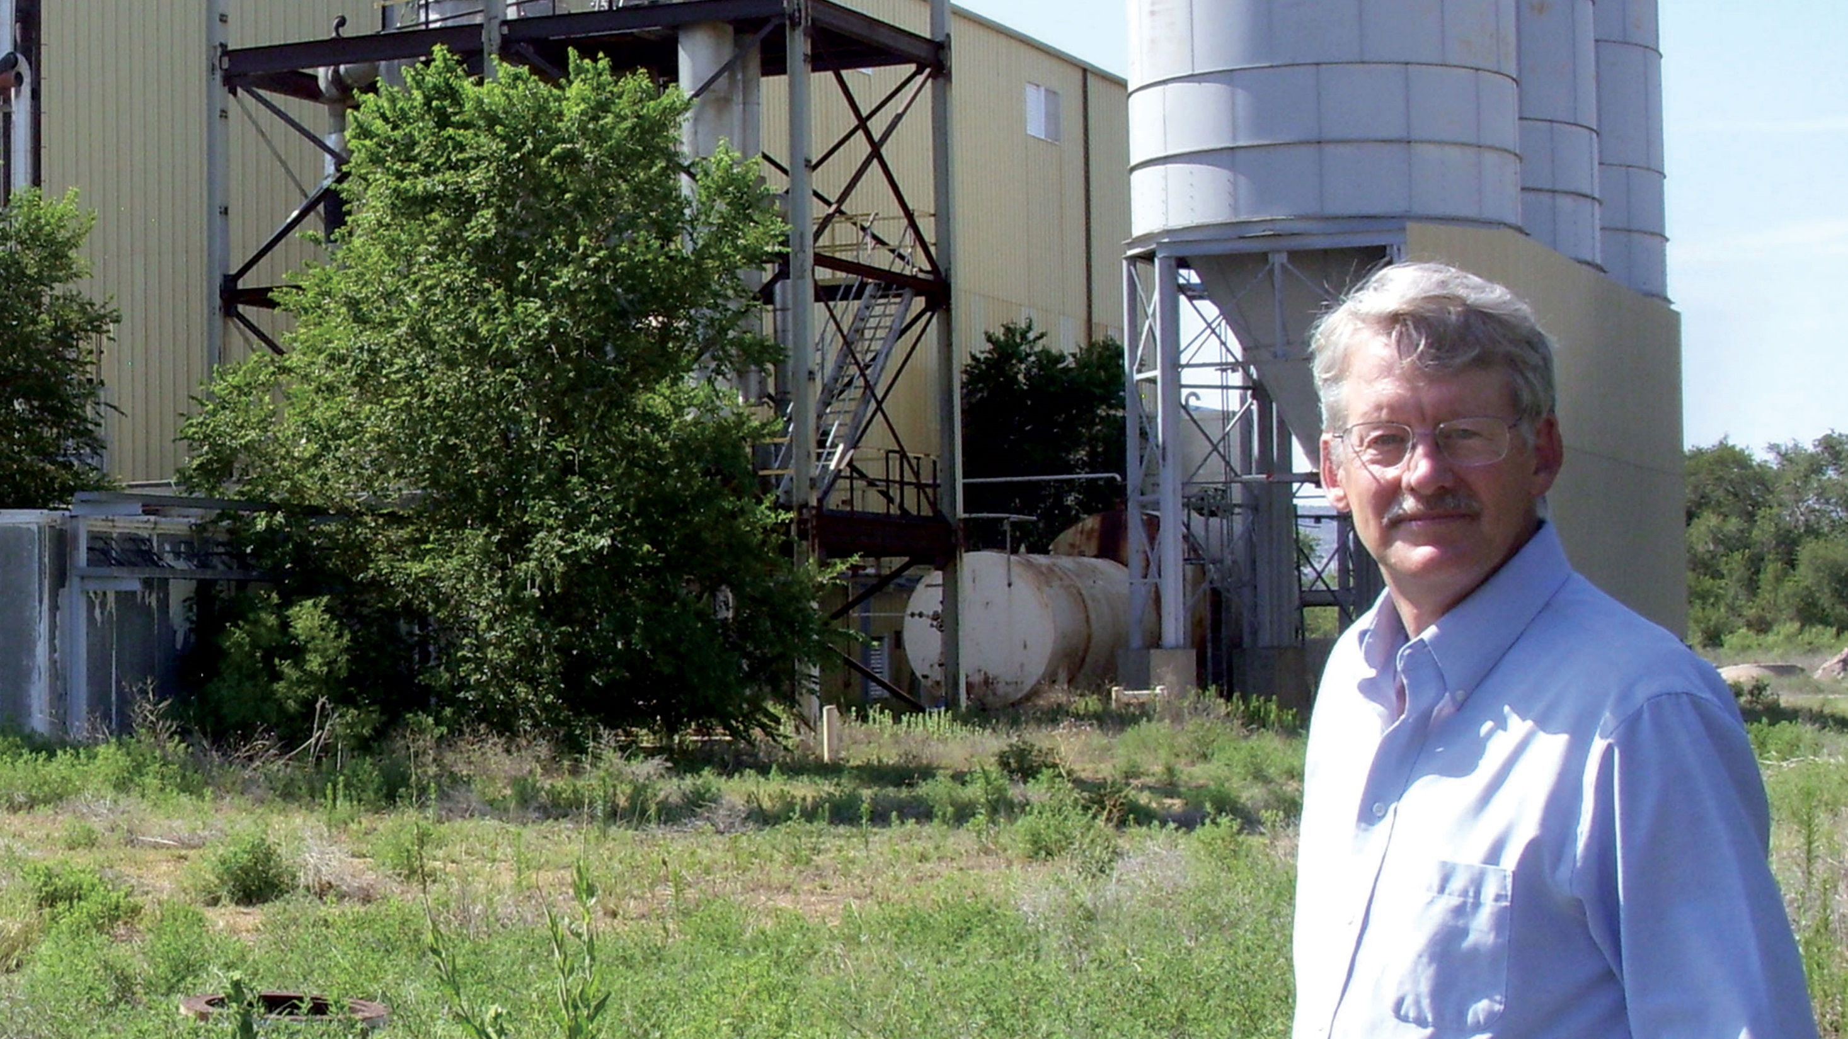
ENERGY RELATED DEVICES
Retrofitted an ethanol plant as a biorefinery, creating not just jobs, but an ecosystem within the community
Company founder: NMSU graduate
20 high-wage jobs
Impact analysis secured LEDA funding ($75,000) and USDA loan ($900,000)

Slide 18

RESEARCH & ANALYSES
Added new program offerings, including Business Modeling, Market Intelligence, and Financial Intelligence assistance
Conducted economic base studies for counties
Conducted economic impact and feasibility analyses for government and business
Success: Created jobs; supported the development of regional entrepreneurship programs
Work Remaining: Conduct public/private research and analyses

Slide 19

Needs and Programs Solutions
SLIDE HERE

Slide 20

KEY CHALLENGES
Limited access to commercialization expertise
  Provided a broad and deep network with a formal structure for access
Access to NMSU labs/facilities
  Created inventory; defined process for access
Demographic and cultural diversity
  Formed strong strategic partnerships with NMEDD and NTU to access innovators and entrepreneurs; added a joint appointment to UC and CES

Slide 21
KEY CHALLENGES
Not all entrepreneurs’ needs are the same
  Developed industry and/or audience-focused programs
Workshop and training attendance
  Assessed the unique makeup and needs of each community to tailor-fit program offerings and reframed promotional messages and workshop content to accommodate diverse audiences
Limited access to capital
  Established pathways to capital through sources like Financial Intelligence assistance, Arrowhead Innovation Fund and micro-grants

Slide 22

Needs and Programs Solutions
SLIDE HERE

Slide 23
PRIORITIES
Talent
  Develop and recruit company founders
  Include focus on women and veteran innovators and entrepreneurs
  Recruit enterprise advisors and other commercialization experts
Corporate engagement
  Increase sources of intelligence on market demand
  Team startups and researchers with established companies
Industry clusters and community initiatives
  Drive industry-focused accelerators
  Extend programs, NMSU resources, and network to communities
Innovation space
  Define requirement for innovation space/makerspace/FabLab/hackerspace

Slide 24

Zetdi Sloan
575-646-7833
zrunyan@nmsu.edu
arrowheadcenter.nmsu.edu/university-center

