Slide 1

CICE Update
March 9, 2017
Paul Latiolais, Director

Slide 2
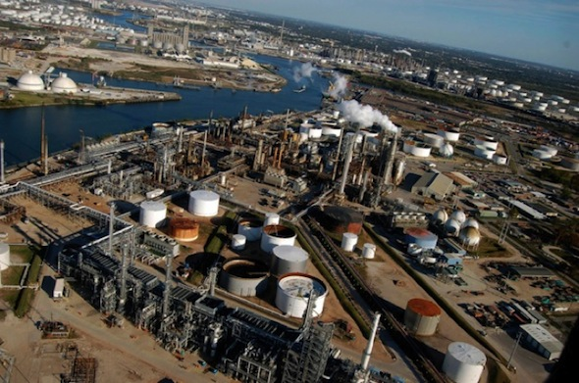
Needs of Region
Landscape
Single industry dependency
High unemployment, poverty
Needs
Economic diversity – introduce innovation-based businesses
Create culture of Innovation
What to do with Lamar University?....

Slide 3

EDA-University Center
U.S Economic Development Administration
Develop innovation-based industries to diversify economy of SE Texas
CICE – Culture of Innovation:
Create Innovation Hubs for Region (9 Counties)
Establish Proof-of-Concept Center (concept to market)
Develop Innovation/Entrepreneurship Support Programs
Innovation
Hubs

Slide 4
CICE Mission
Mission
Leverage technology, expertise, and infrastructure of Lamar University’s research and business centers
  Establish new innovation-based industries
  Support efficiency improvements for established industries
Work intimately with regional dev organizations & businesses
  Expand market opportunities
  Enhance the region’s economic capacity
Objectives
Assess and commercialize technologies
Provide process to accelerate businesses to market
Create a “hub” of innovation & entrepreneurship
Encourage investment in the region

Slide 5

Mission – Culture of Innovation
Economic Development
Startups
Soft Landings
Economic Dev Consortium
Faculty/Student Innovation
Grants = Commercialization
Business Planning/Execution
Idea Development/LU Centers
Industry Collaboration
Symposiums, Workshops
Visualization Centers
Industry/University Projects
Community Outreach
Education
University-led Forums
Workforce Development

Slide 6

CICE Purpose
Support Innovation, Commercialization, and Entrepreneurship
Encourage Innovation Development with Faculty (Engr/Business)
Bring University Innovations to Market
Engage Students
Establish Collaboration between University and Industry
Become Regional Innovation/Entrepreneurial Hub
Encourage Collaboration across Universities, Professional Organizations

Slide 7

Economic Tool to
Diversify & Grow Region
Develop Innovation Hubs
  Energy  Software  Digital Learning
  Advanced Materials  Air & Water Quality  Port Mgmt Systems
Welcome new interests in Energy via Soft Landings
  Joint project with Chamber and Industry
Student Engagement
  Internships
  Student Projects
Air & Water
Quality
Energy
New Spinoff
Lamar Centers
Nano, Micro Labs
HPC Center
Port Mgmt
DLC
Software & Electronics
Advanced Materials

Slide 8


Tenant Clients
Tenant Clients (Committed)
  CIMR Tech – air sanitization in healthcare, residential http://www.cimrtech.com/
  T&L Solutions – technology collaborator for petrochemical plants and oil refineries
  Southern Creole Foods – international markets
  IBWell – biotech simulation/analysis (faculty startup)
Soft Landing Clients (Potential)
  CoreWorx – PM software for industrial construction
  Ryze Materials – upcycle textiles for Nike®, UnderArmour®, and others ($100M investment) https://ytexas.com/2015/07/newly-formed-ryze-renewables-announces-port-arthur-hq/
  Brasilian Industry and Services – metal fabrication for energy industry (Brasil)
Textile recycling company to bring 500 jobs,
$200 million investment to Port Arthur

Slide 9

Student Engagement
Tech Analyst (Student)
Business Analyst (Student)
Tutor
Encourage “real-world” exposure
  Client projects, Courses, Bootcamps
CICE Internships
Competitions
RBPC Planning & Prep
Faculty/Student “Spark” Projects
Ignite! Entrepreneurship Trek
  Rice University, TMC, UC-Davis
  Engineering, Science, Business students
Students
Students

Slide 10

Interdisciplinary Freshman Experience
Interdisciplinary Teams
Challenges
Promote critical thinking, collaboration, communication, teamwork
Lamar University’s Strategic Initiative
  1 of 5 Strategic Initiatives
Engr
Bus
CS
Scien
Art

Slide 11

CICE Programs
Program | Location
Workshops in Innovation, Design Thinking | Training Center/Hatchery
Innovation Bootcamp (September) | Training Center (Gill, Lawson, George)
Faculty/Student Research Spark Awards | Work Area (Across Departments)
Student Idea Development | Student Hatchery
CICE Student Internships/Projects | Student Work Area
Workforce & Professional Development | Training Center, Computer Lab
Rice Business Plan Prep | Boardroom
Ignite! Student Experience | Silicon Valley & UC-Davis, Rice, TMC
Big Idea Competition (April) | Training Center, Hatchery
Chamber & Community Events | Event Center, Boardroom
Industry Symposiums | Visualization Center
Client Consulting, Soft Landing | Office Area – 2nd Floor
Program Location
Interdisciplinary Freshman Experience Training Center/Hatchery
Innovation Bootcamp Training Center (Gill, Lawson, George)
Faculty/Student Research Spark Grants (Across Departments)
Student Idea Development Student Hatchery
CICE Student Internships Student Intern Center
Workforce Development Training Center, Computer Lab
Modeling & Simulation Computer Lab
Big Idea Competition Training Center, Hatchery
Chamber & Community Events Boardroom, Training Center
Notes:
Innovation Bootcamp – fast-paced product-to-market workshop over weekend; inaugural event Sept 16-17, 2016 (CoE, local entrepreneurs)
Faculty/Student Spark Awards – project-based funding to spark new research (sponsored by CICE)
These are “immediate programs” to be deployed in 2017. Other programs are under consideration.

Slide 12
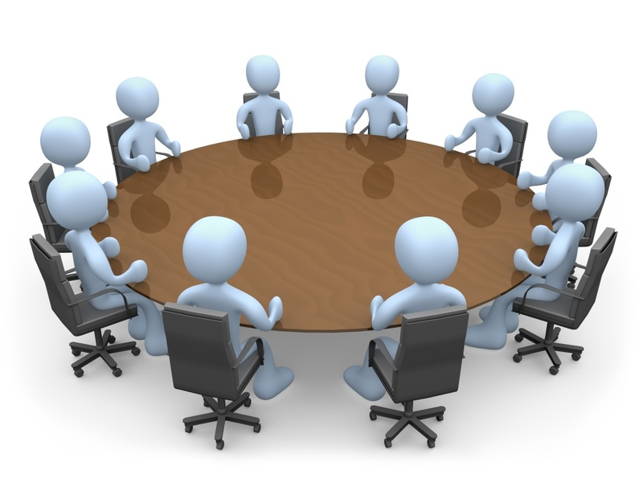
CICE Advisory Council
Dr. Jack Gill (Chairman) Gill Foundation (Houston) Founder
Larry Lawson eCardio (Houston) Founder
Anthony George FuelTrax (Houston) Founder
Kelvin Collard Universal Aviation (Houston) CFO
Gene Arnold Financial Services CEO (retired)
Ed Sturrock AmeriCommerce (CapOne) Founder
Bart Simmons Oil & Gas Finance Founder
Others under discussion…

Slide 13
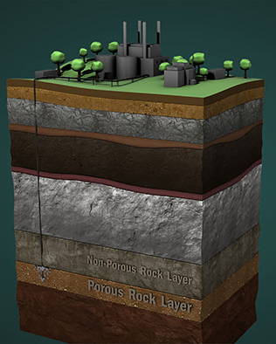
Challenges/Setbacks
University, Resources
University research (create pipeline) → Commercialization
Collegiate silos (bridging organization)
Building Grant requirements (Workforce Development)
Regional
Innovation Corridor (Houston, Austin)
Investment Capital – “Deal Flow” (Angel Network)
Industry Awareness (Big projects, IR, Key clients)
CarbonSAFE
CO₂ Storage

Slide 14


CICE Facility
20,000 sf
16 Offices + Conference Rooms
4 Labs (2 Wet, 2 Multipurpose)
3 Training Rooms
Event Center
Modeling & Simulation Center
Idea Hatchery
SBDC Integration

Slide 15
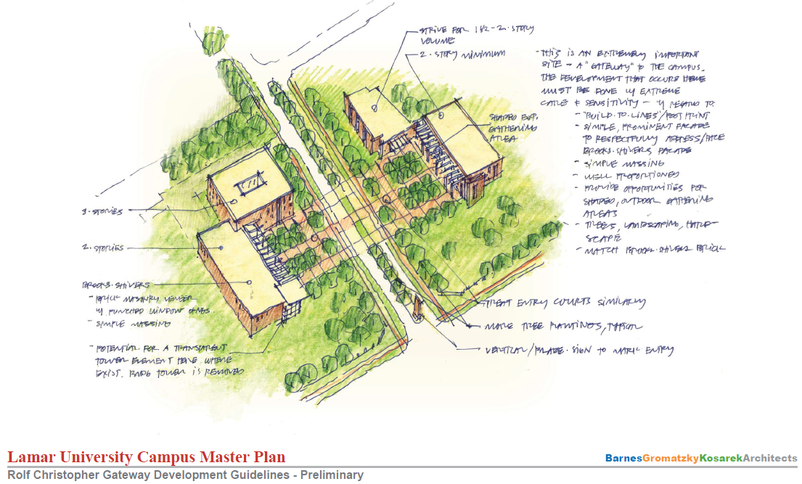

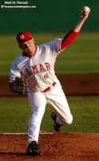
“Gateway” to Lamar University
Innovation Corridor
NEW
Commercialization
Center
S & T
Rolfe Christopher
CICE
NEW
Admin Bldg
ADMIN
Jim Gilligan Way

Slide 16
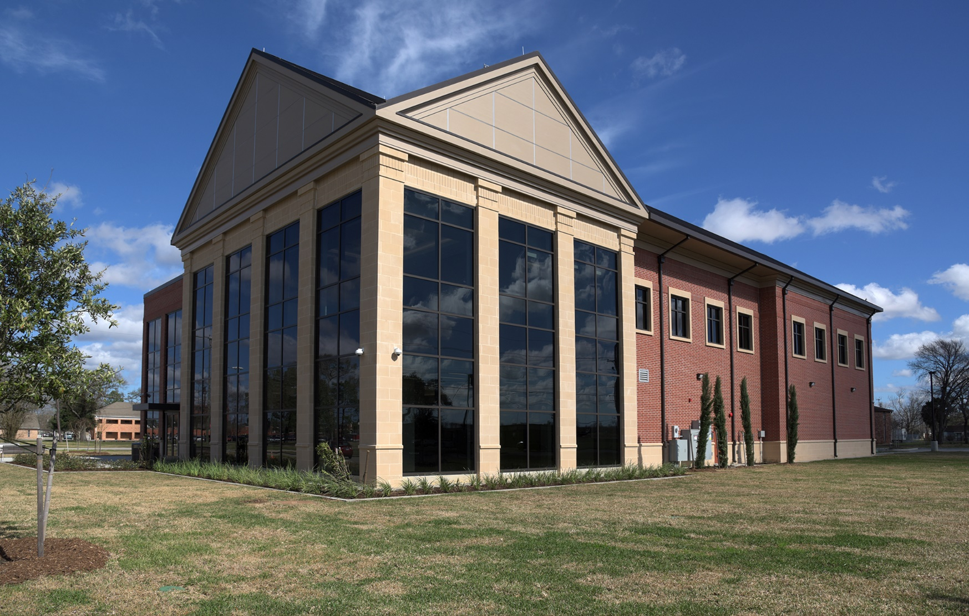
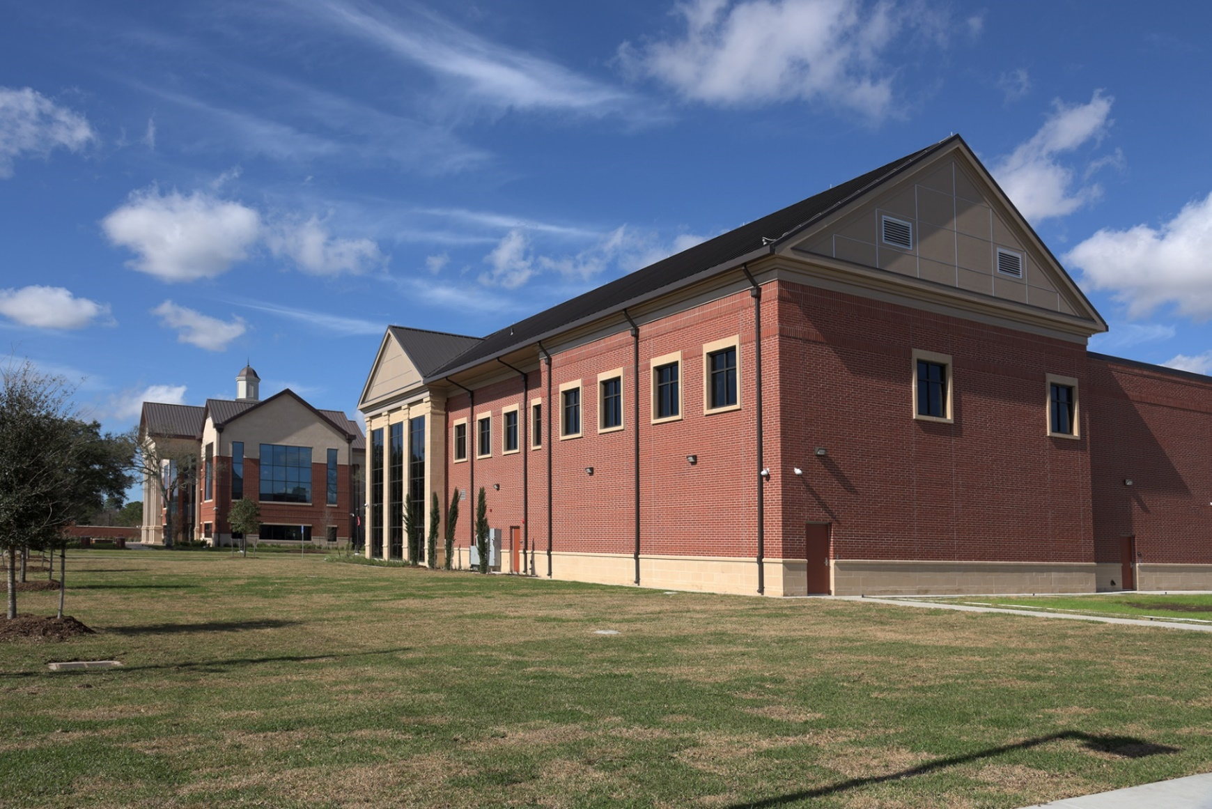
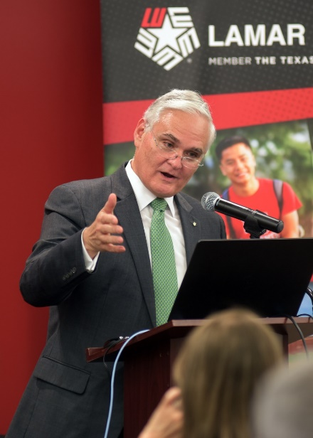
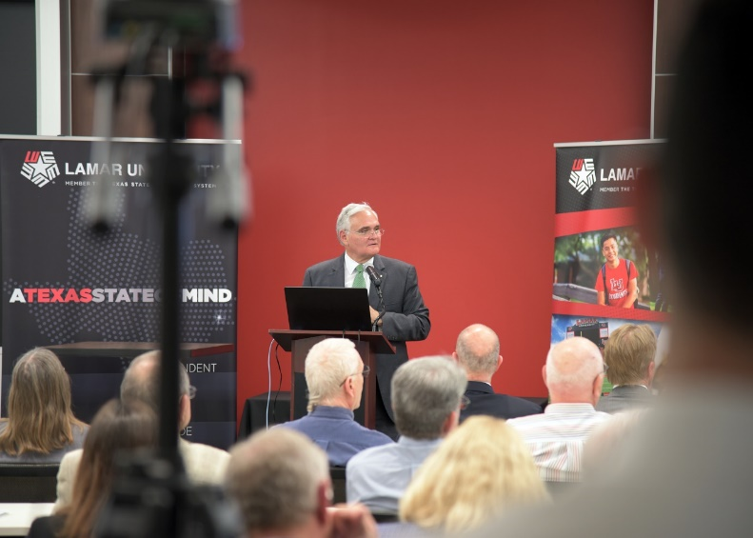
CICE Building

Slide 17

CICE Building
Mech/EE
Labs (2)
1st Floor
Wet Labs (2)
Computer Training
Center
Workforce Dev
Support/Intake
SBDC
Training &
Event Center
(Holds 100+)
Interdisciplinary Freshman Experience
Entre Bootcamp
Seminars, Classes
Job Fairs
Student Idea
Hatchery

Slide 18
CICE Building
2nd Floor
Student Intern Center
Students
Tech Analyst (Student)
Business Analyst (Student)
Tutor
Students

Slide 19
2nd Floor
Center for Innovation, Commercialization & Entrepreneurship
Port
Mgmt
Port
Mgmt
Digital
DLC
IBW
1-Day
Cowork
HPC
Center
Break
Room
Claimed
Tentative
Student Work Area
Staff
TBD
(Visitor)
(?)
Synergy
XP
Students
Tech Analyst
Business Analyst
Tutor
Potential Clients
Synergy XP
LEARN Center
Chamber Soft Landing (1-2)
Students
Core
Worx
Director
Assoc.
Director
Pgm
Mgr
Southern
Creole
CIMR
Tech
T&L
Solns
Boardroom
SBDC Offices
on 1st Floor
Conference
Room

