Slide 1
Educational Association of University Centers
Our Mission: Foster positive economic transformation through higher education…

Slide 2
Agenda
Welcome and Introduction
  Dan Ripke
  Bernadette Grafton
Webinar session topics:
  Update from EAUC, Dan Ripke
  Update from EDA, Bernadette Grafton
The Regional Innovation Strategies Program

Slide 3
Updates from EAUC
EAUC Meeting at the UEDA Annual Conference in Reno
  Discussion of EDA University Center priorities (resource identification, success stories, practices)
University Economic Development Association Annual Conference
  Bernadette Grafton attended
  Dennis Alvord, EDA’s Deputy Assistant Secretary for Economic Development, Department of Commerce, participated in a “fireside chat” with CSU, Northridge President Diane Harrison
EAUC Membership 2020
  Discount to the EAUC annual conference
  Newsletter/News/Legislative Updates
  Members Only Web Content
EAUC Annual Conference in Washington DC – March 2020

Slide 4
Educational Association of University Centers Annual Conference
Week of March 15th, 2020
US Department of Commerce, Economic Development Administration (EDA)
US Dept of Labor
National Institute of Standards and Technology (NIST)
Dept of Defense
US Dept. of Agriculture
National Science Foundation
US House of Representatives staff
US Senate Staff
Brookings Institution
Heritage Foundation
University Government Relations Officers
National Association of Development Organizations
International Economic Development Association
National Association of Counties
Panels of University Center Directors to speak about innovative programs and projects

Slide 5
Update from EDA
Upcoming Events
  2019 National Brownfields Training Conference in Los Angeles, CA: Dec 11-13
New Tools
  The Regionizer http://www.statsamerica.org/reg
  USA Opportunity Zones Tool www.statsamerica.org/opportunity
New Notice of Funding Opportunity (NOFO)
  FY 2020 Public Works and Economic Adjustment Assistance Programs (PWEAA)
  Accelerate R2 Network Challenge
Notes:
Intro Self,
Her role at EDA
Introductions of those on the call
Purpose of the webinars
Vision moving forward
Switch to Dan
Note: Under lack of strong value proposition for the program, focus on the need to develop a clear description of what this program is, what it is for, who it is for, and what outcomes we are seeing from the program at large.
Note: Under “where are we going”, focus on how this webinar is one of many regular webinars that will serve as a gathering place for UCs to learn from other UCs, ask questions, share ideas, make connections, and stay up to date on the latest news regarding the program.
Like any Federally funded program, it’s important to continue to make the case as to why the funding for the UC program is necessary and what outcomes we are seeing as a result of it. We must be able to clearly and effectively state why University Centers have been a key stakeholder group for the EDA and how they have been promoting and encouraging economic development in their regions (change this phrase – look at NOFO).
I’ll turn it over to Dan Ripke, the current Executive Director of the Educational Association of University Centers, for more details on this as well as some history of the program. Dan has been in the UC world for decades and is therefore a great resource for us all!

Slide 6
EDA Funding Opportunities
Public Works and Economic Adjustment Assistance (known as PWEDA)
  Applications accepted on a rolling basis
Short Term Planning and Local Technical Assistance
  Applications accepted on a rolling basis; new NOFO to be available soon
Regional Innovation Strategies (RIS) Program
  “Expects to announce competitions/grant opportunities for FY2020, pending appropriations.”
2019 Disaster Supplemental (new)
  Applications accepted on a rolling basis
  Funding available for communities impacted by natural disasters in 2018 and Floods and Tornadoes in 2019
University Center Program
  Next funding cycle: FY2021 (CRO and PRO)

Slide 7

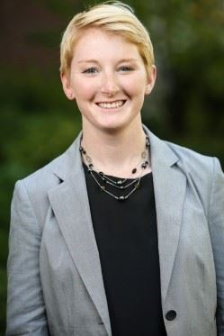
Our Speakers this month
Craig Buerstatte
Emily Miller

Slide 8
The RIS Program
the seventh round
EDA’s 2019 regional innovation strategies program consisted of the i6 challenge and seed fund support grant competitions – awarding ~$23.5 million to support innovation and entrepreneurship driven economic development.
https://www.eda.gov/oie/ris/
EDA anticipates releasing NEW competition in early 2020
Applications may be due as early as March 2020

Slide 9
i6 challenge
desired activities
The i6 challenge funds a range of programs and services that support innovation-based, high-growth entrepreneurship and startup acceleration through services such as technology advisement, market evaluation, business planning, mentorship, and access to early-stage capital.
Project funds cannot be given directly to startups.

Slide 10
Seed fund support (SFS)
desired activities
The sfs grant competition provides funding for technical assistance, operational costs, marketing, and outreach related to the planning, formation, launch, or expansion of cluster-based seed capital funds that deploy capital in innovation-based startups with a potential for high growth.
Project funds cannot be used to capitalize a fund, or invested in a startup.
Notes:
A seed fund is an equity-based investment fund that generally focuses on companies less than three years old and with annual revenues under $1 million and that is operated by one or more professional fund managers.
These managers develop an investment strategy, capitalize the fund with investment capital from one or more institutions or individuals, and deploy the investment capital by funding early-stage companies in exchange for equity stakes in those portfolio companies.

Slide 11
The RIS Program
past funding caps & project periods
i6 challenge
$750k Federal funds cap; min. 1:1 match required
3 year project period
2019 i6 Awards - https://www.eda.gov/oie/ris/i6/2019/
seed fund support (sfs) grant competition
$300k Federal funds cap; min. 1:1 match required
3 year project period
2019 SFS Awards - https://www.eda.gov/oie/ris/seed/2019/
Notes:
REMIND applicants that its $750K/$300K total over three years, not per year

Slide 12
Accelerate R2 Network Challenge
$1 Million Challenge to create a nationwide network or networks of organizations working to address the nation’s most pressing disaster response and resiliency (R2) challenges with innovative technologies. The Accelerate R2 Network Challenge seeks to connect stakeholders engaged in:
Response innovation – innovation in the communications, technology, and equipment first responders use when responding to disasters and events
Resiliency innovation – finding new ways to build, protect, and connect networks and infrastructure to help communities recover and build readiness and resilience in the face of future disasters
Potential Applicants Include: Teams with regional or national connections that can convene multiple stakeholders in the R2 industries to collaborate an increase entrepreneurship and technology commercialization
https://www.eda.gov/oie/accelerate-r2/
Informational Webinar: Nov 20th, 2:00 pm ET
eda.gov/oie/ris •
follow us:
regional offices: Atlanta • Austin • Chicago • Denver • Philadelphia • Seattle

Slide 13
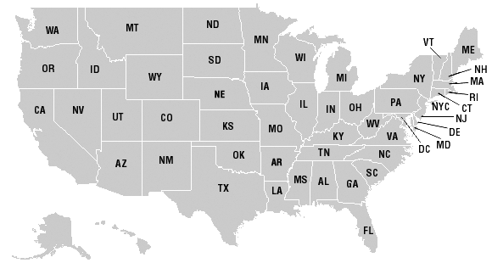
The “R2” Asset
a “team” of Response & Resilience experts
eda.gov/oie/ris •
follow us:
regional offices: Atlanta • Austin • Chicago • Denver • Philadelphia • Seattle

Slide 14
Grow “R2” industry
a network to stimulate growth
eda.gov/oie/ris •
follow us:
regional offices: Atlanta • Austin • Chicago • Denver • Philadelphia • Seattle

Slide 15
Maturing “R2” industry
to deploy programs and polices for scale
eda.gov/oie/ris •
follow us:
regional offices: Atlanta • Austin • Chicago • Denver • Philadelphia • Seattle

Slide 16
QUESTIONS?
Look out for the next Regional Innovation Strategies (RIS) competition in early 2020
  https://www.eda.gov/oie/ris/
View “R2 Network Challenge” webinar & other Resources
  https://www.eda.gov/oie/accelerate-r2/
eda.gov/oie/ris •
follow us:
regional offices: Atlanta • Austin • Chicago • Denver • Philadelphia • Seattle

Slide 17
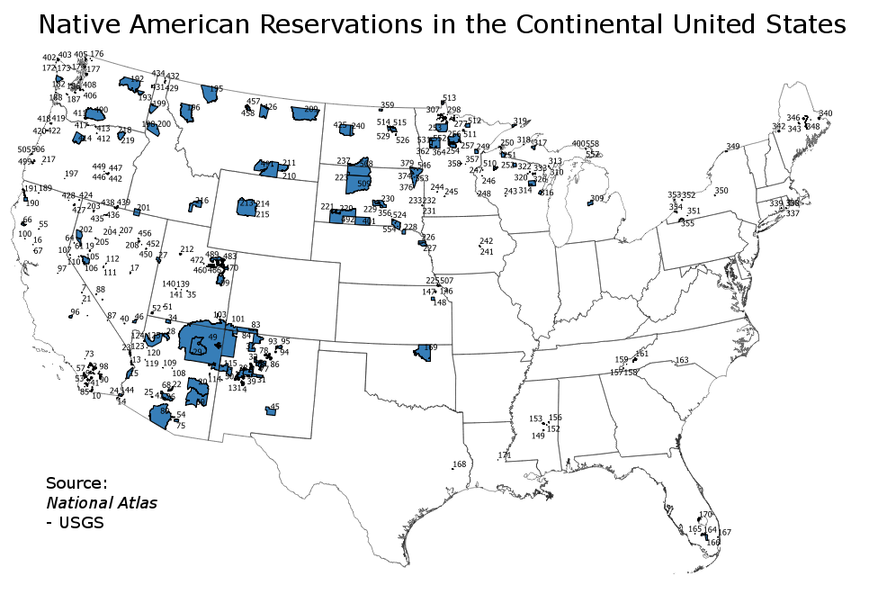
EDA Announcements - General
EDA Tools and Resources
  www.statsamerica.org
  https://www.eda.gov/programs/university-centers/ - Updating your PDFs
Engaging with the Tribes in your region
  https://en.wikipedia.org/wiki/Indian_reservation
Notes:
As you can see on the map, there is a tribal presence in most states!! In the US, there are 326 Indian reservations and 567 recognized tribes!
Universities may be able to play a role in beginning to explore the importance of these tribes as economic engines in the community(ies) they serve. There are 2 things we know:
almost all reservations in the US are in a rural areas, and
where these reservations are located, they are (almost always) the largest employer for that area.
Tribes could be excellent partners in the work that some UCs are doing and it’s something to consider as we move forward with strengthening the UC program across the U.S..
I’m curious to see how many of our UCs are currently engaging with tribes in their regions and, if they are, what that engagement looks like. Please respond to the poll questions I have just put up.

Slide 18
Questions/Reminders
Video of this Webinar will be posted within the next 2 weeks
EAUC Spring Meeting in Washington, DC – Seeking Conference Committee Volunteers
Next Webinar – Wednesday – January 22, 2019 3pm Eastern

